Slide 1
Phoenix Advanced near surface modeling for Big Data DeepTrace The most advanced neural net picker in industry
Front Range Geosciences

Slide 2
Phoenix Functionality
Standard first break picking tools
Manual pick displays, including advanced offset plane picker
Standard algorithmic automatic pick routines (threshold, energy onset, etc)
Geometry and polarity QC analysis (via delay time analysis)
Near surface modeling
Delay time analysis
VNS (Variable Node Spacing) tomography
ANS (Adaptive Node Spacing) tomography.

Slide 3
Phoenix was designed to meet several goals
Handle Big Data surveys.
Billions of traces, thousands of square miles
Accomplished via Distributed Project Logic
Provide the most advanced travel time tomography and delay time algorithms
Serve as a platform for more advanced technology

Slide 4
DeepTrace Functionality
Using modern Deep Learning techniques for computer vision, DeepTrace achieves state-of-the-art accuracy for automated picking.
Using model ensembling, DeepTrace makes multiple picks and uses statistical reasoning to find the best fit, while providing confidence intervals.
DeepTrace is constantly improving as it is trained with new and more varied data. It can be exclusively trained on client in-house data to provide best results.

Slide 5
Demonstration of Phoenix + DeepTrace on difficult land data
Data courtesy of Schlumberger
76 million traces, 200 square miles
Illustrate the effectiveness of Phoenix and DeepTrace working together
Compare Phoenix tomography algorithms
Compare Phoenix results to legacy software

Slide 6
Demonstration outline
Import SEGY – define header map, generate project files.
Define moveout trend - used to flatten gathers for DeepTrace
Use the moveout trend to make an initial set of DeepTrace picks
Use these picks to generate an initial tomography model
Use the initial tomography model to flatten gathers and generate final set of DeepTrace picks
Use these picks to generate various tomography (ANS, VNS) and delay time solutions.
Use 3rd-party picks to generate models using same parameters – picks in this case are standard flatirons methodology utilizing threshold auto picks followed by copious hand editing requiring extensive analyst time

Slide 7
DeepTrace picking methodology
Define a moveout trend, 15 minutes user time. A moveout trend is not required to run DeepTrace but tends to improve results
Generate the first set of DeepTrace picks using the moveout trend to approximately flatten the seismic. Run time less than an hour.
Use the initial DeepTrace picks to generate a tomography model (VNS in this case). Run time 6 hours on a 4 node cluster.
Generate the final set of DeepTrace picks using the tomography model to flatten the seismic. Run time 2 hours on a 4 node cluster.

Slide 8
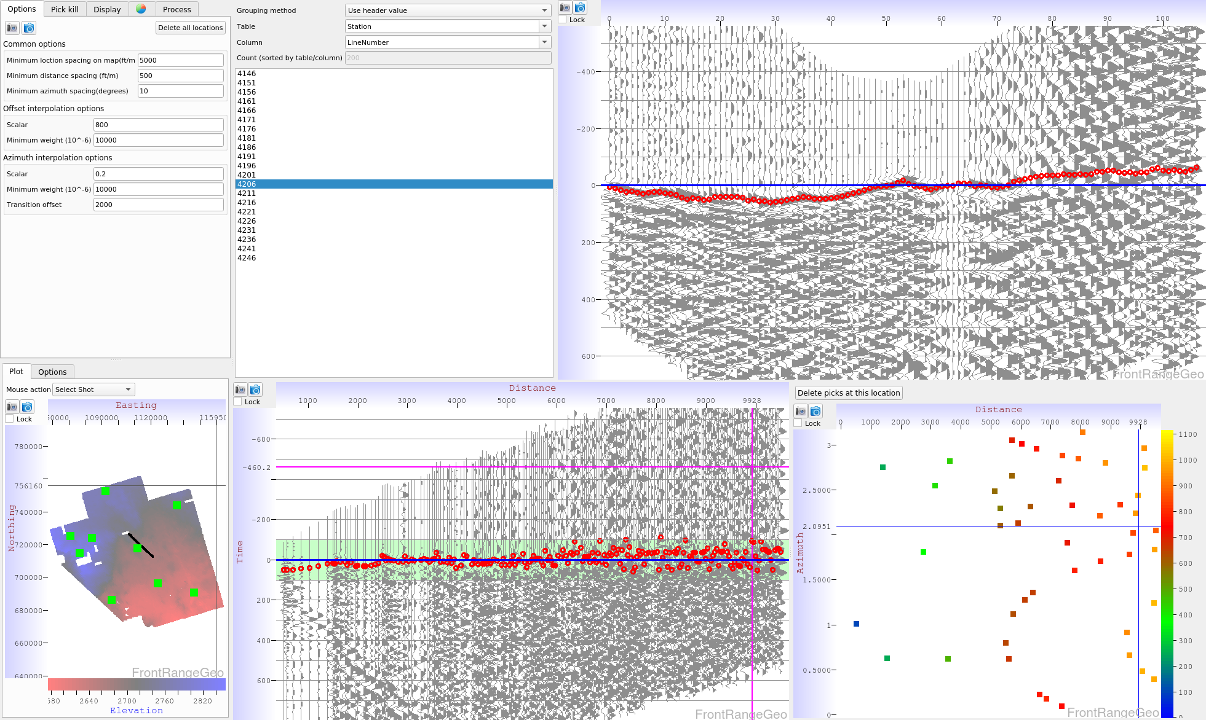
Moveout trend definition
Moveout trend is a function of both offset and azimuth, and varies spatially
across the survey. The azimuthal terms are necessary to handle complicated near
surface geology

Slide 9
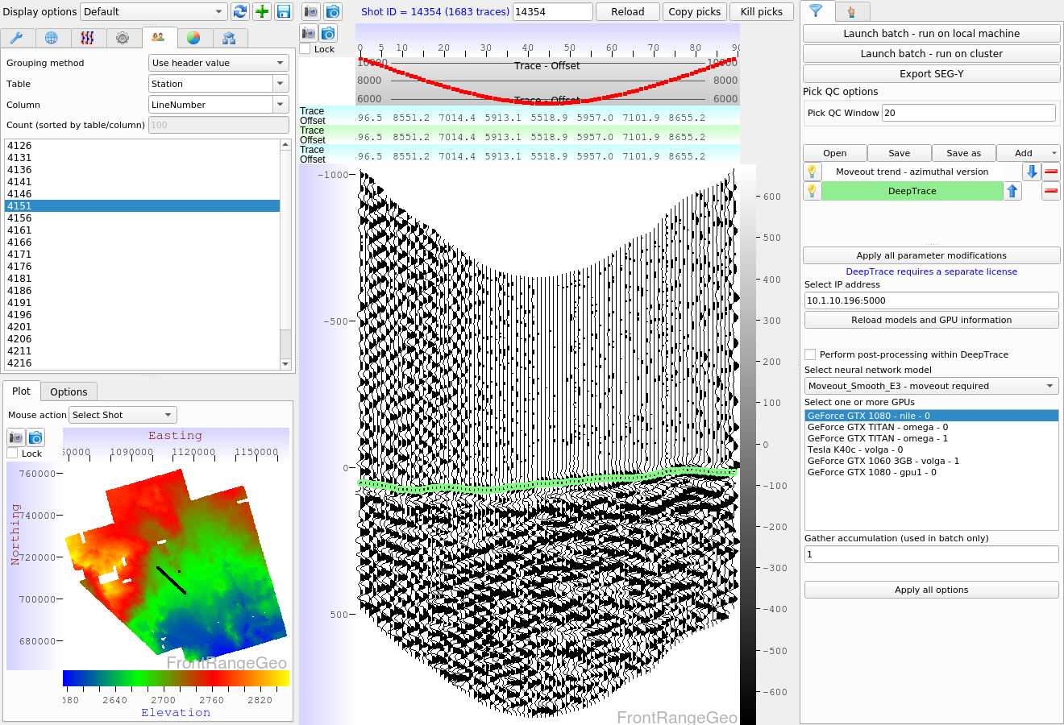
DeepTrace picking – option selection
Batch picking is started by selecting
One of these options
Various options may be tested here,
such as AGC, Filters, trace stacking, etc
Select the neural network
Select any number of GPUs
DeepTrace has various model options. Get quick first-pass results in minutes using the ‘smooth’ models. Use the ‘sliding’ models to achieve the most accurate on-event picks. This test was performed using the ‘smooth’ model set.

Slide 10
DeepTrace results
Total time to generate a final set of picks was about two days. This includes time to generate an initial VNS tomography model.
The resulting picks have not been modified in any way
On the following slides DeepTrace picks are shown in green, human picks in red for comparison
The gathers have been flattened using an ANS tomography model

Slide 11
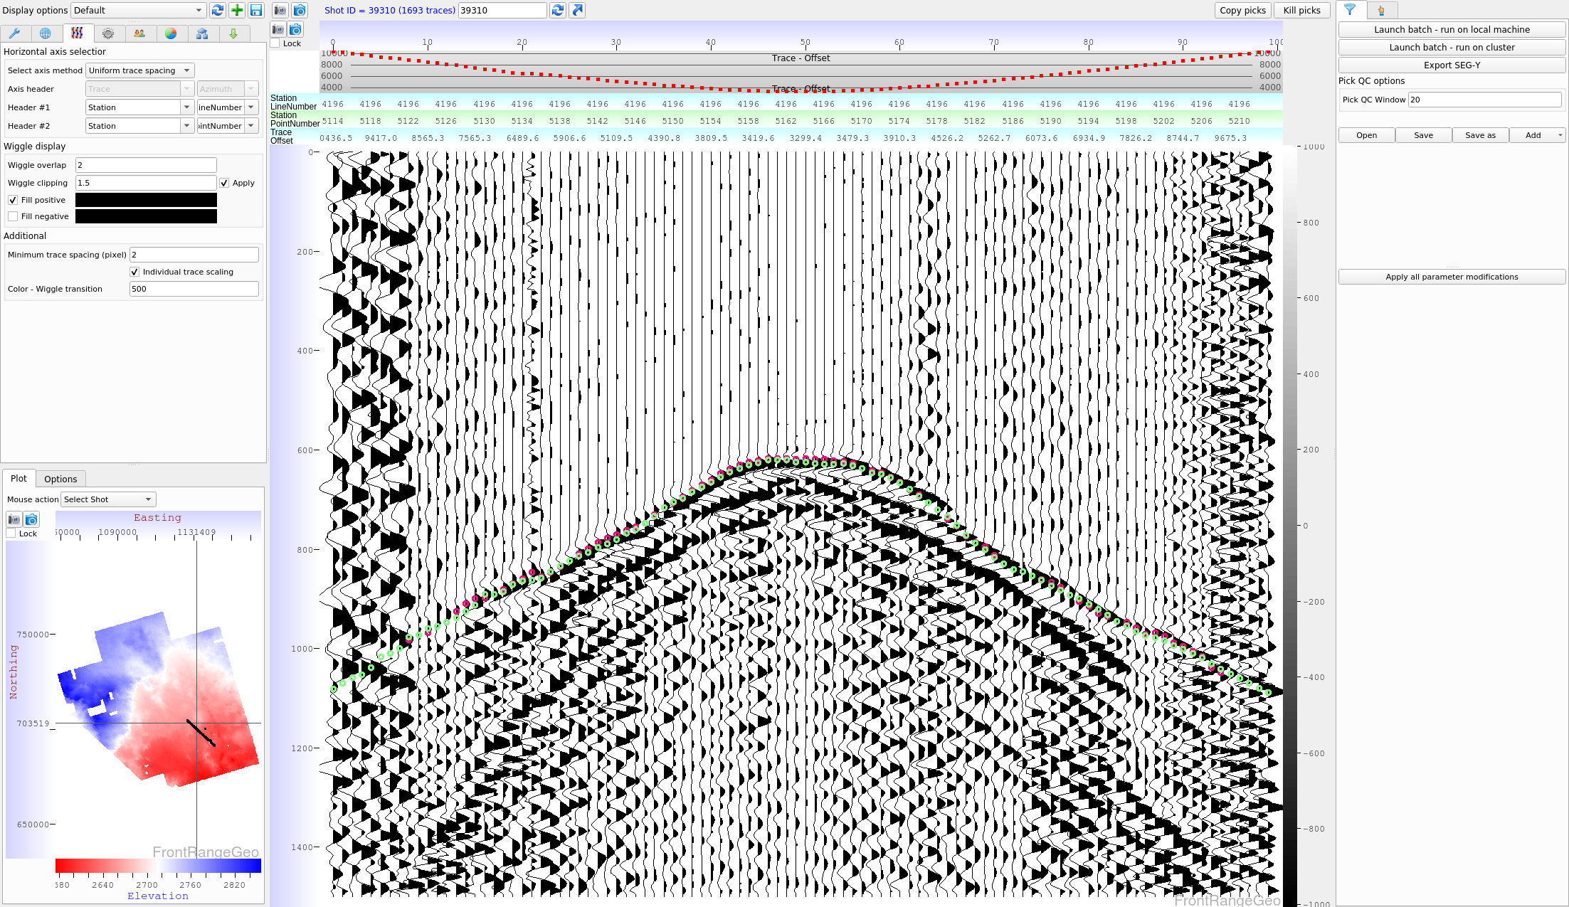
Pick example – easy data
DeepTrace picks
Human picks

Slide 12
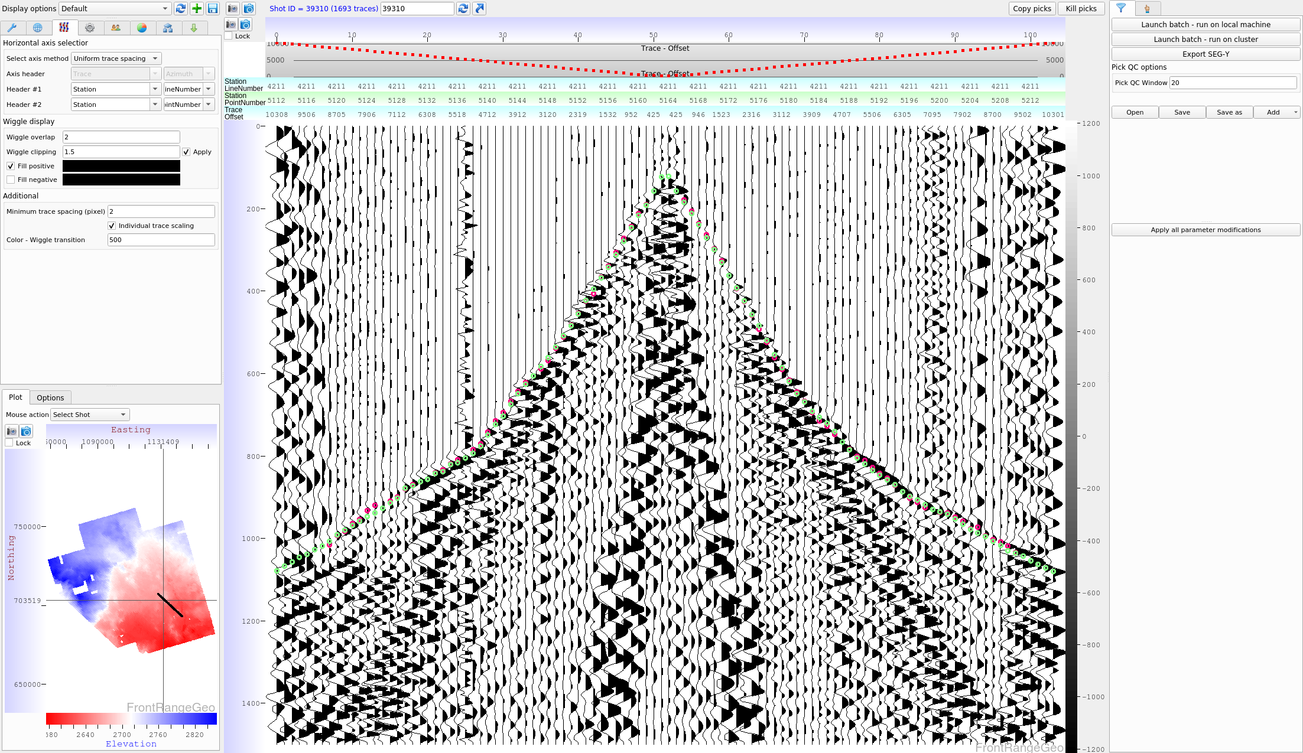
Pick example – easy data
DeepTrace picks
Human picks

Slide 13
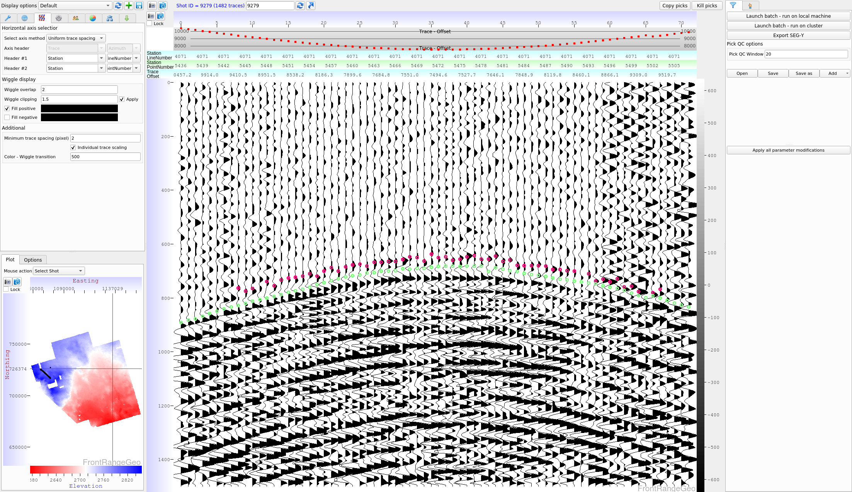
Pick example – easy data
DeepTrace picks
Human picks

Slide 14
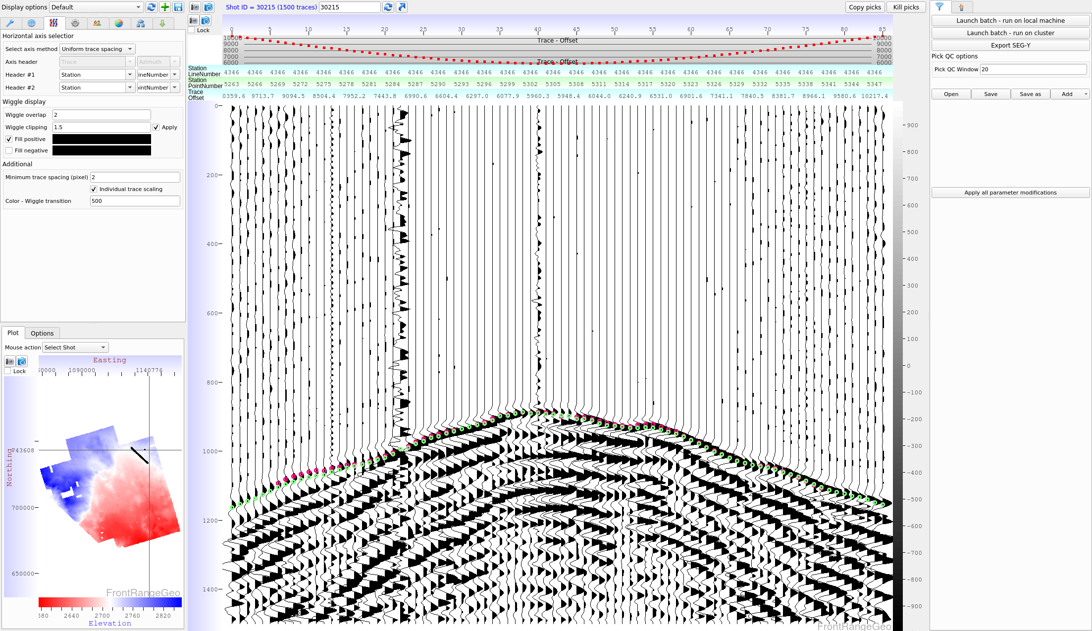
Pick example – easy data
DeepTrace picks
Human picks

Slide 15
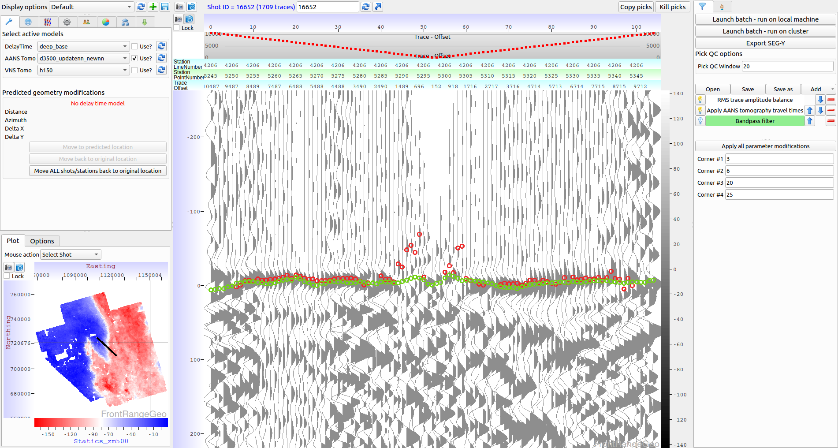
First break pick example
DeepTrace picks
Human picks

Slide 16
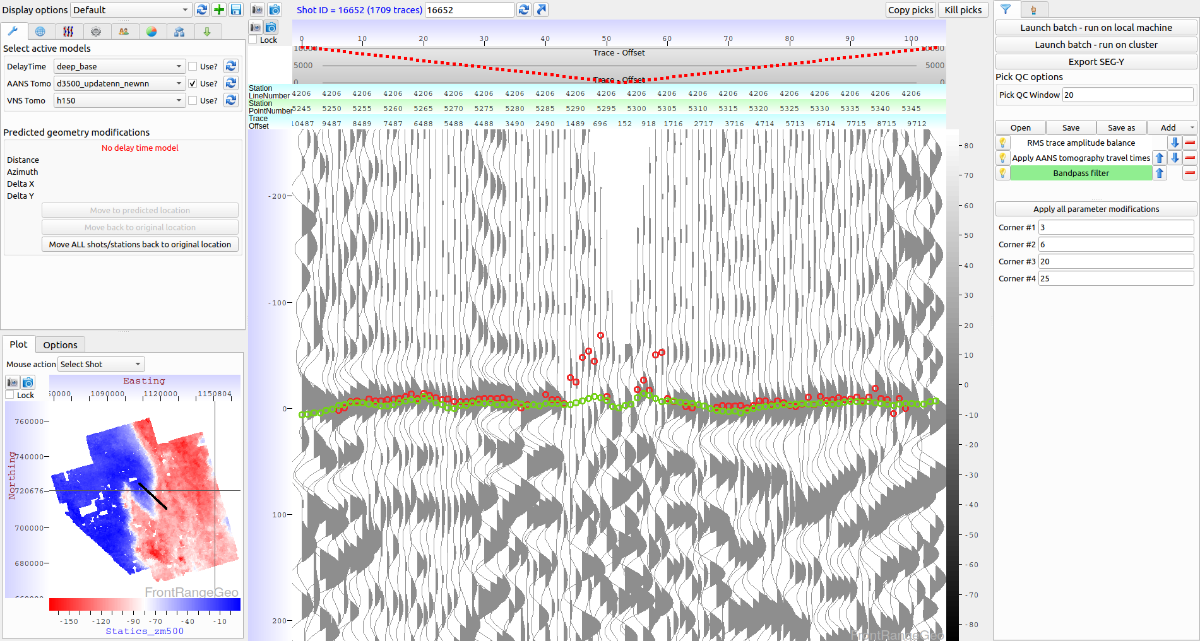
First break pick example – bandpass filter
DeepTrace picks
Human picks

Slide 17
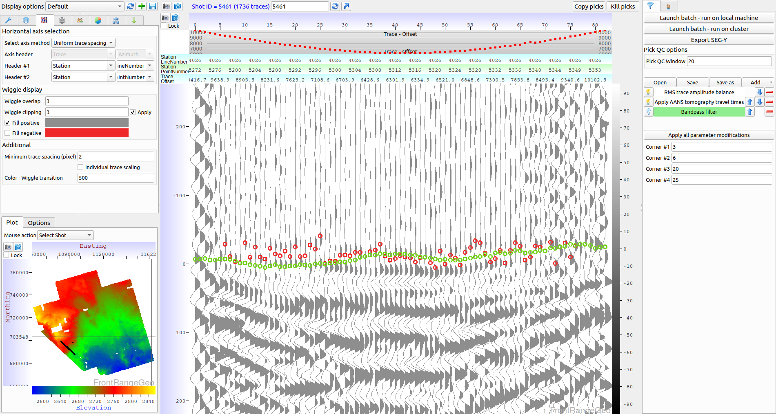
First break pick example
DeepTrace picks
Human picks

Slide 18
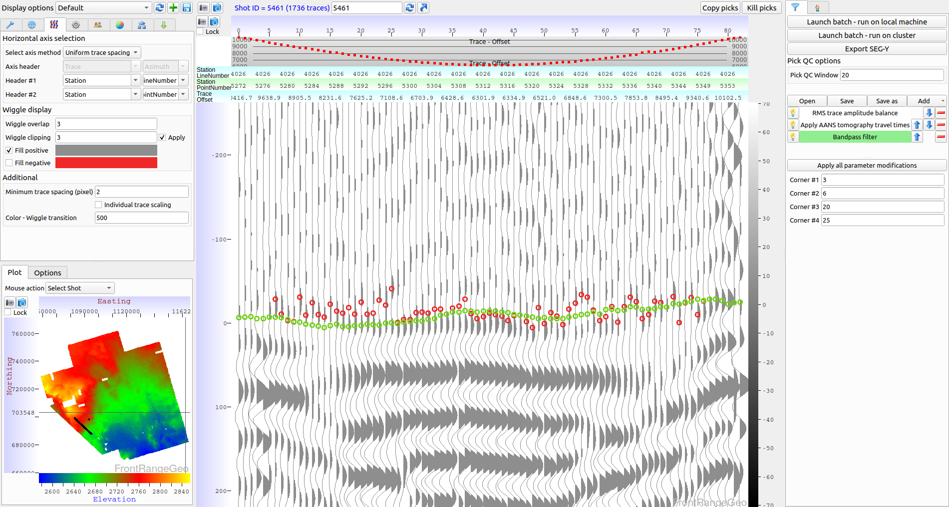
First break pick example – bandpass filter
DeepTrace picks
Human picks

Slide 19
First break pick example
DeepTrace picks
Human picks

Slide 20
First break pick example – bandpass filter
DeepTrace picks
Human picks

Slide 21
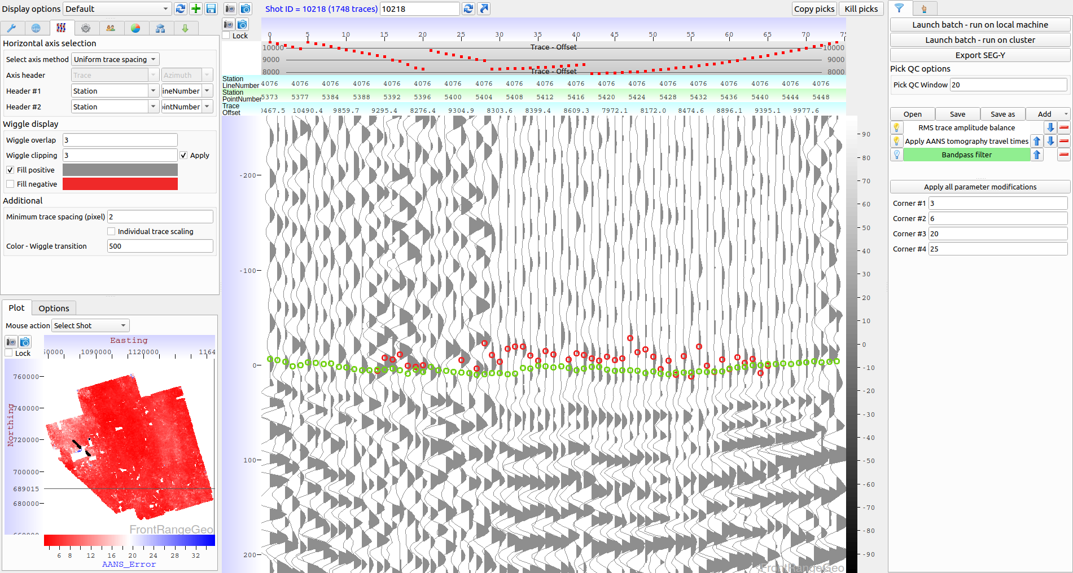
First break pick example
DeepTrace picks
Human picks

Slide 22
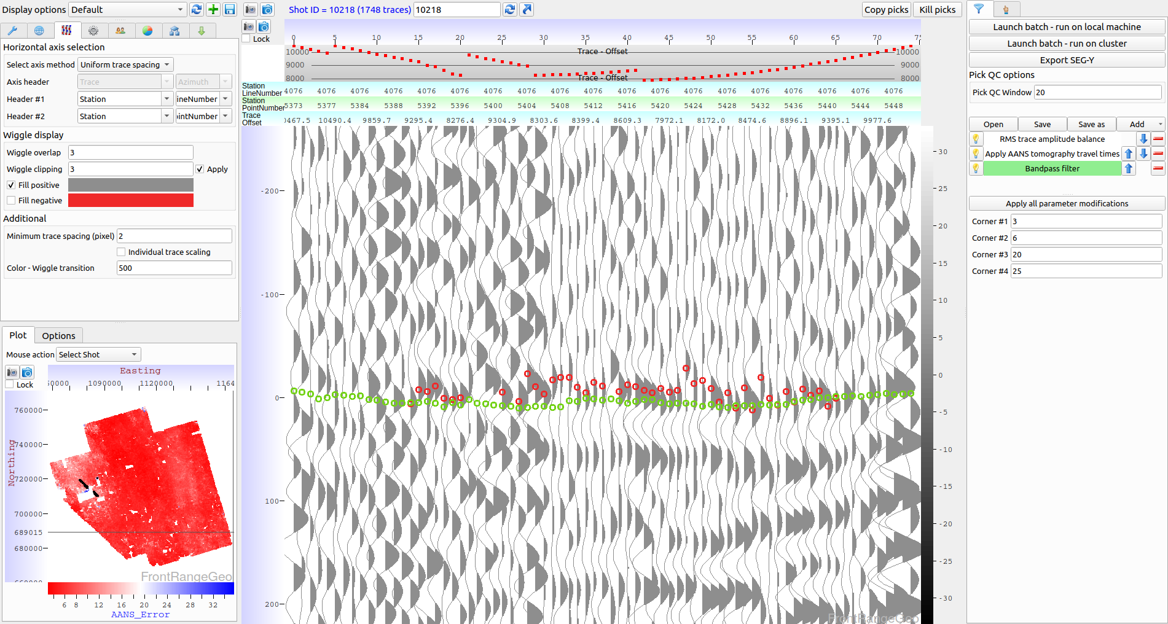
First break pick example – bandpass filter
DeepTrace picks
Human picks

Slide 23
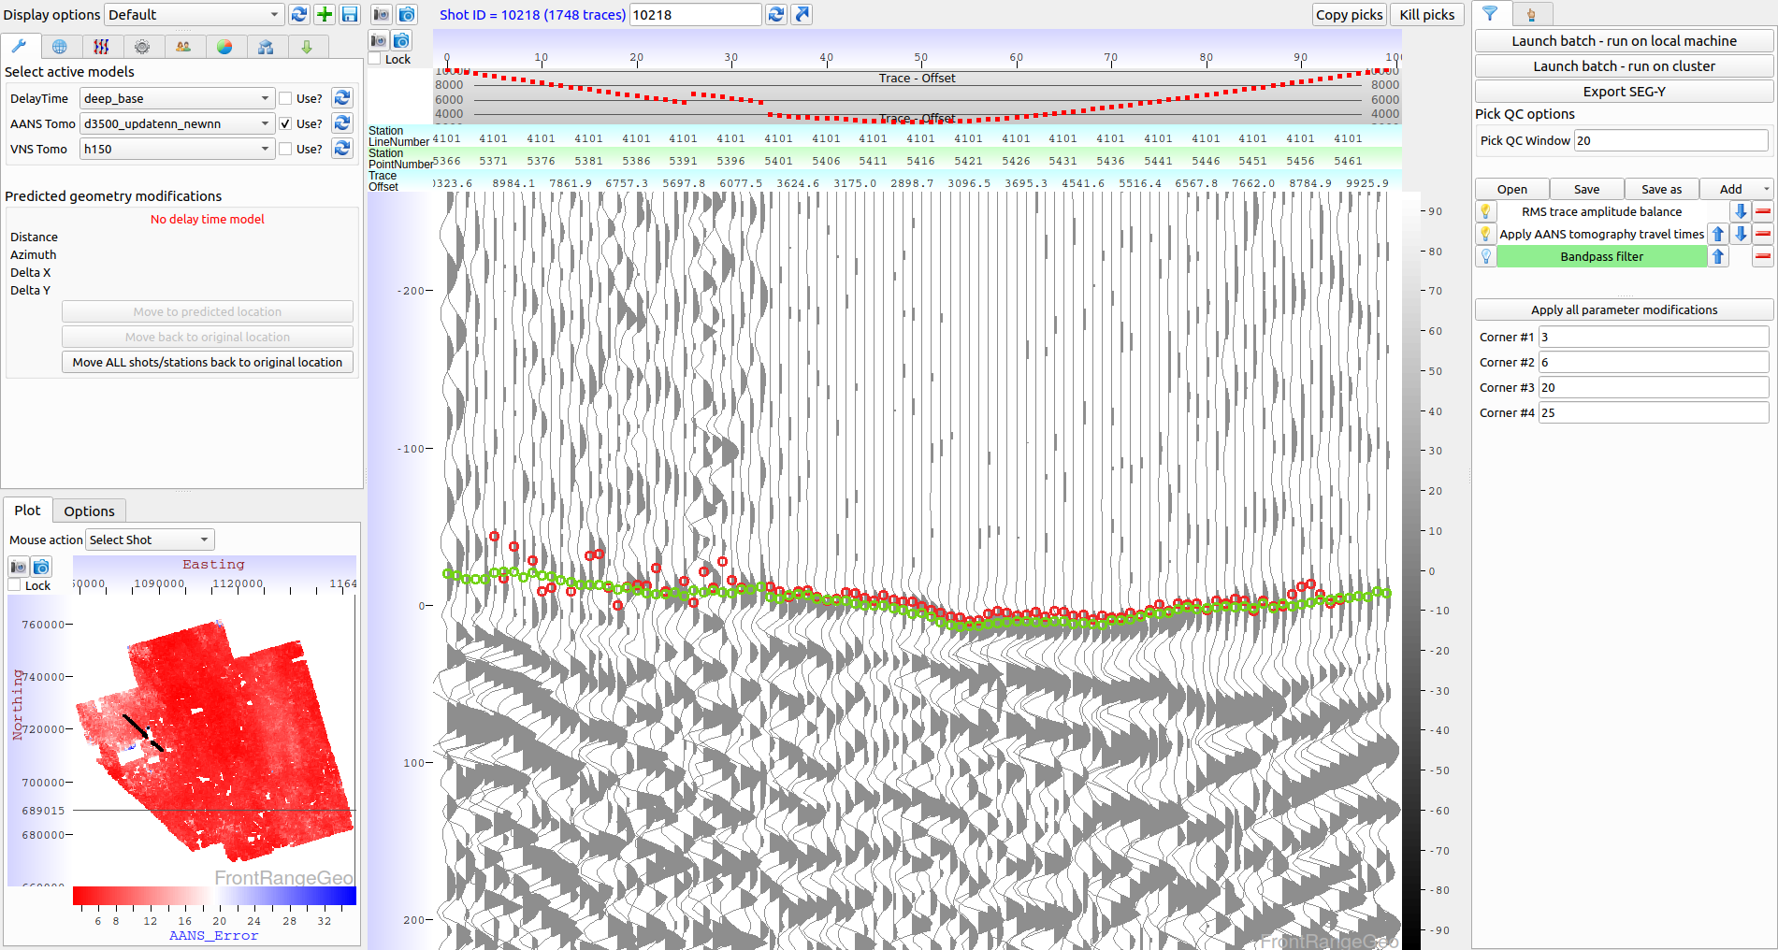
First break pick example
DeepTrace picks
Human picks

Slide 24
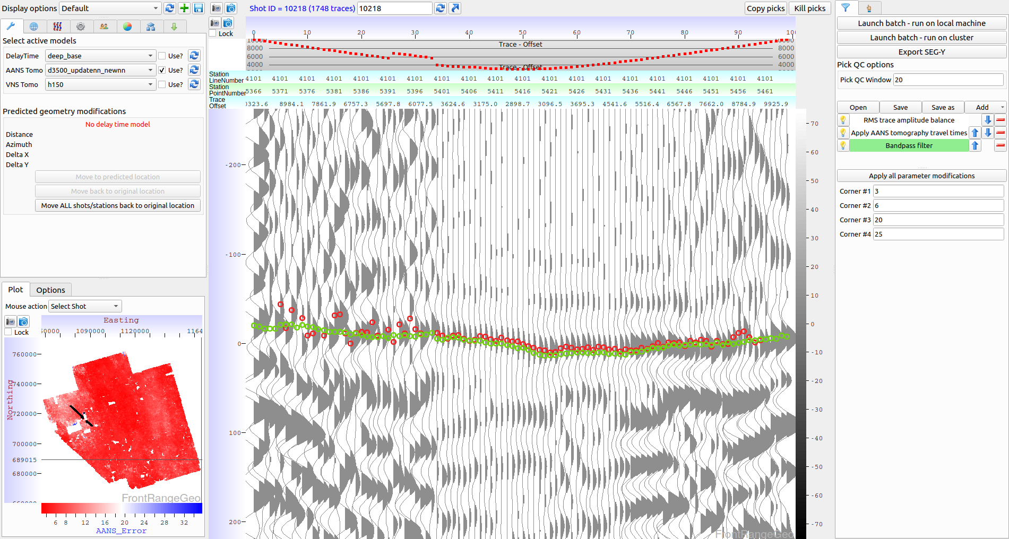
First break pick example – bandpass filter
DeepTrace picks
Human picks

Slide 25
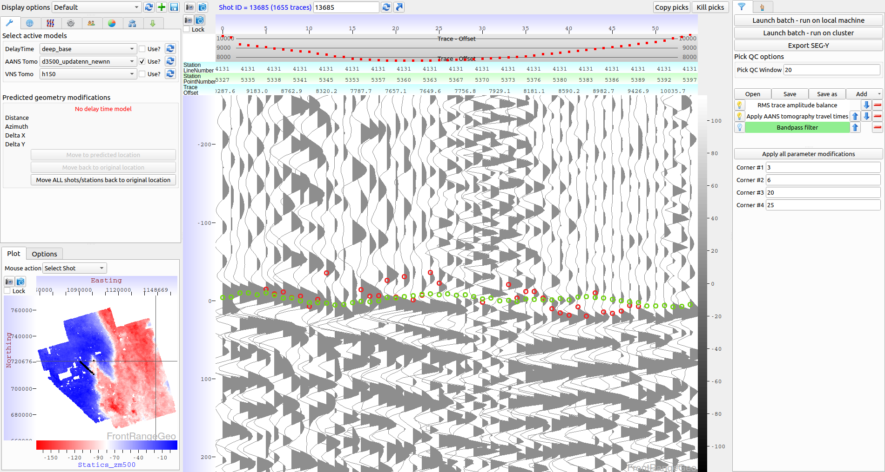
First break pick example
DeepTrace picks
Human picks

Slide 26
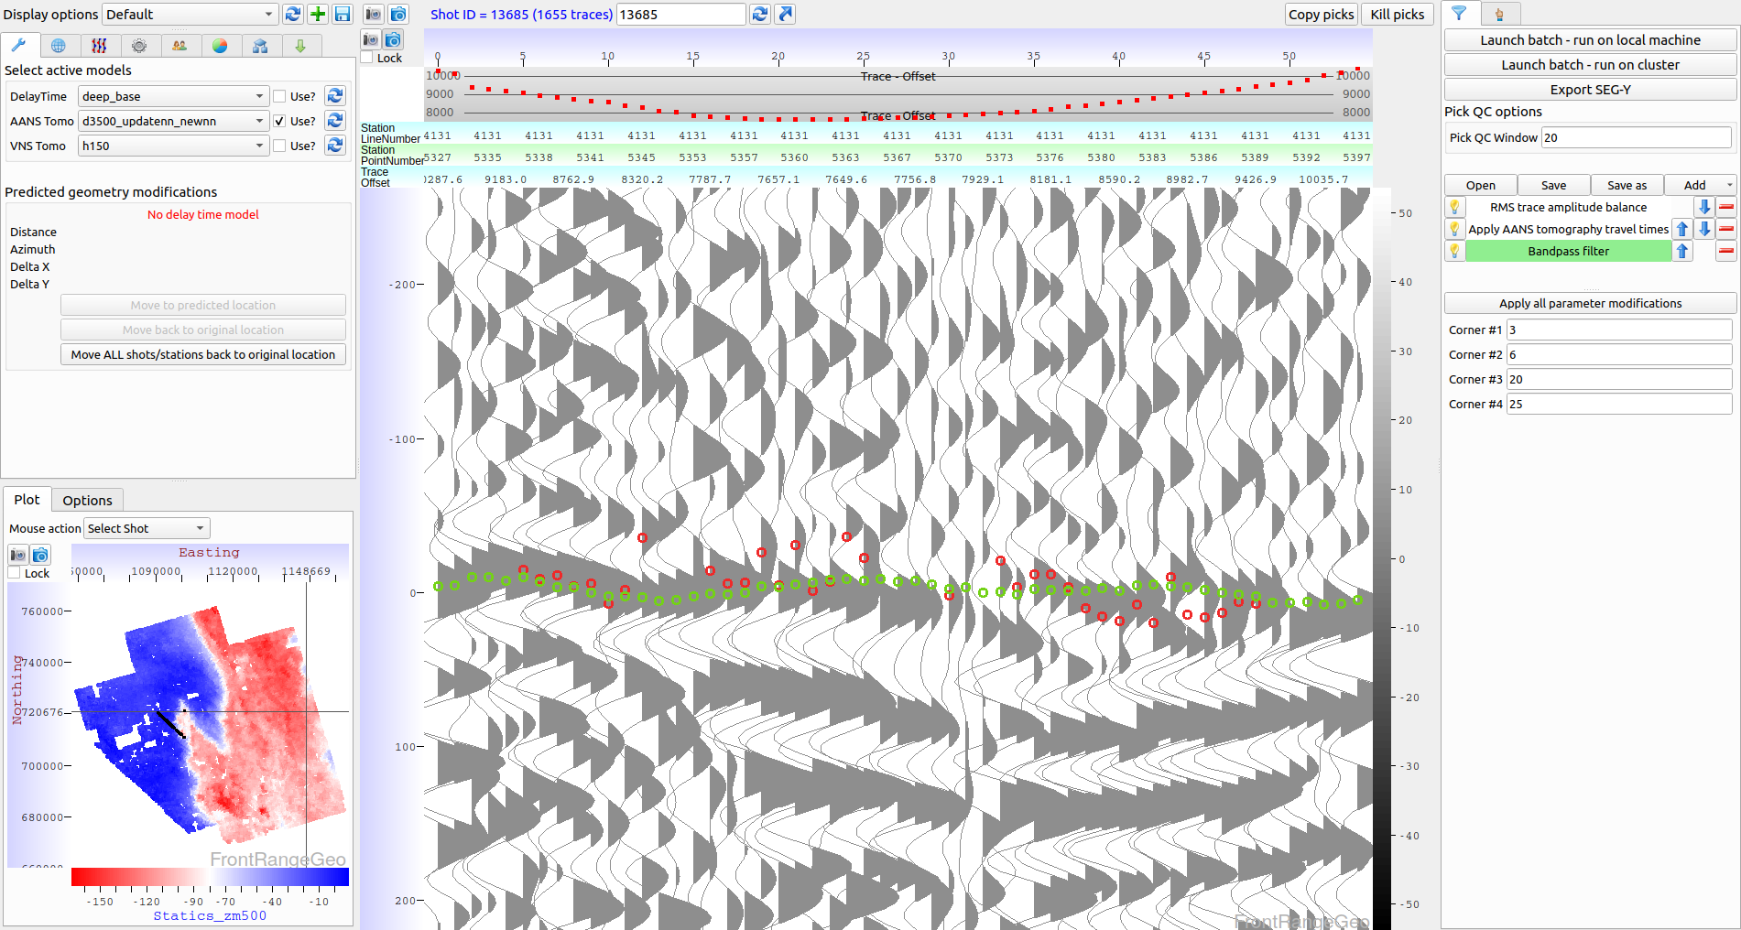
First break pick example – bandpass filter
DeepTrace picks
Human picks

Slide 27
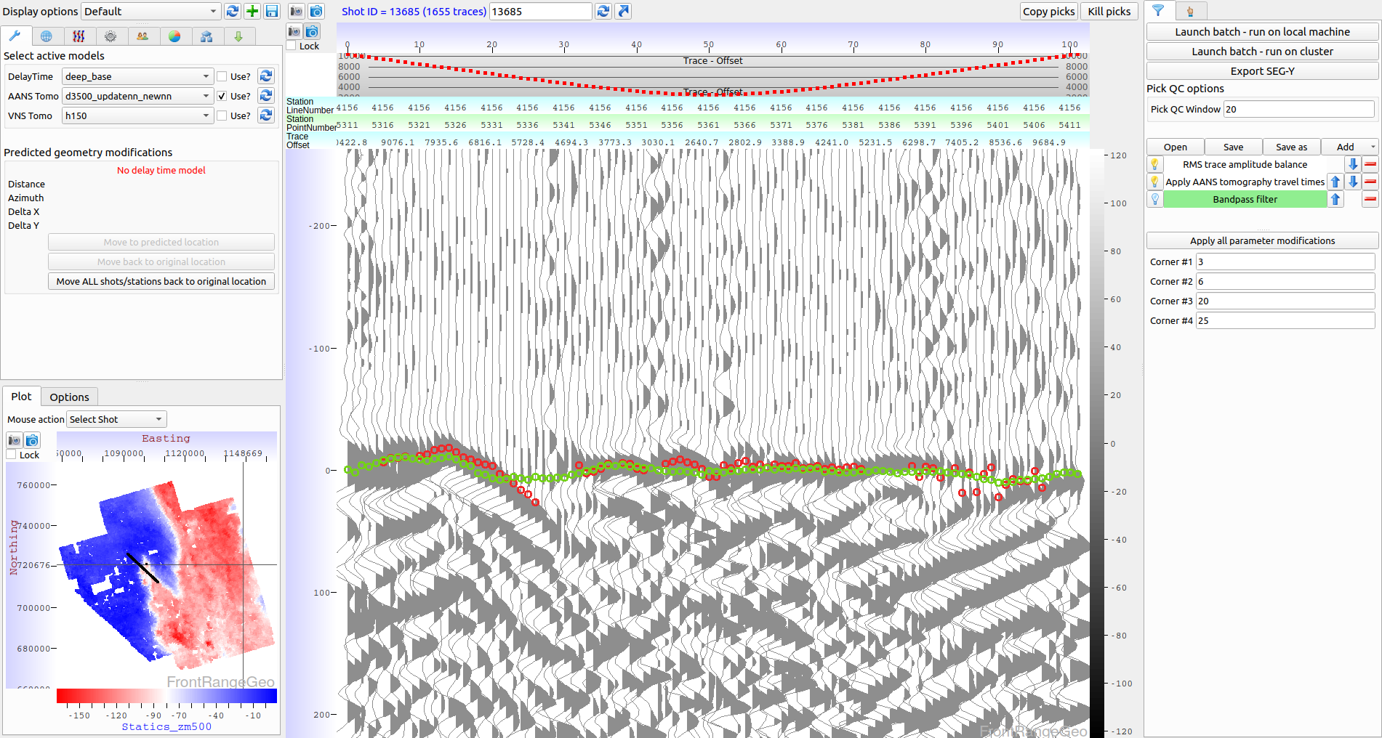
First break pick example
DeepTrace picks
Human picks

Slide 28
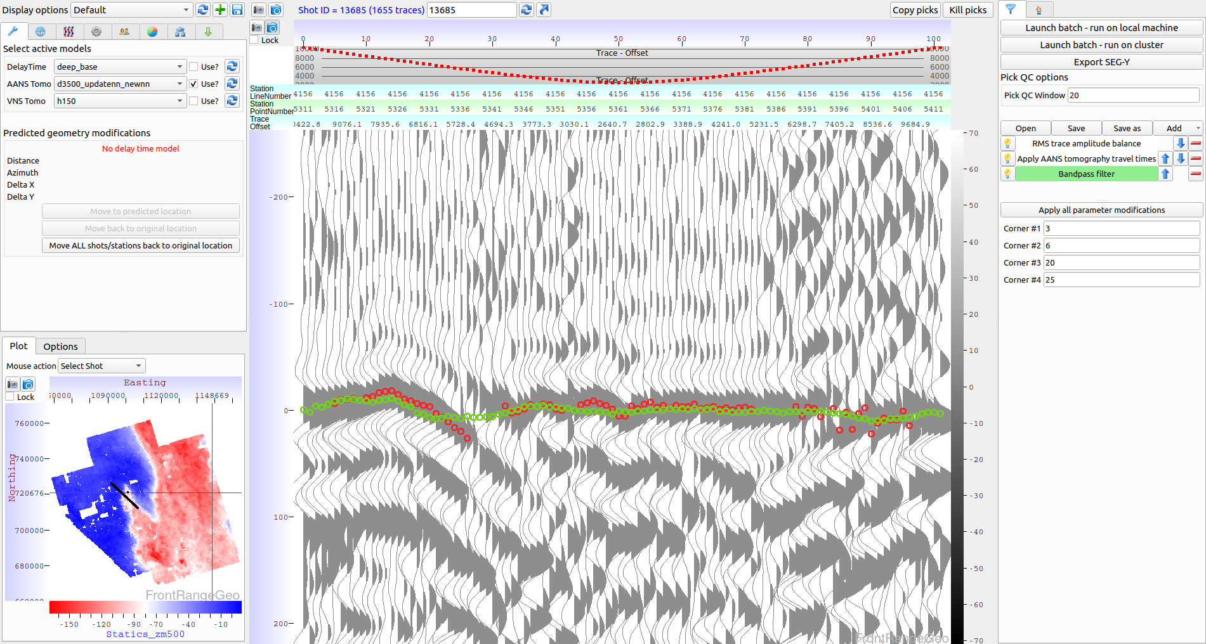
First break pick example – bandpass filter
DeepTrace picks
Human picks

Slide 29
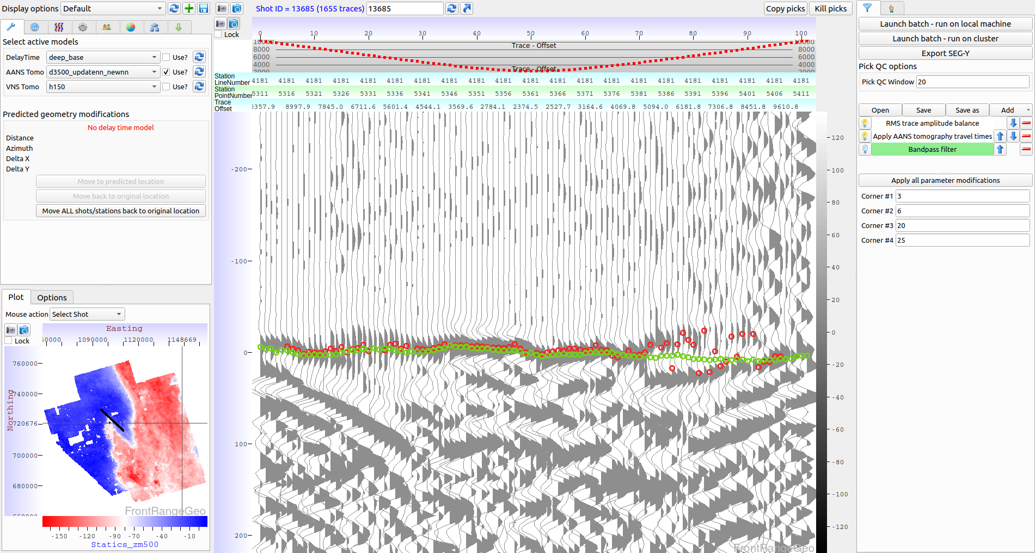
First break pick example
DeepTrace picks
Human picks

Slide 30
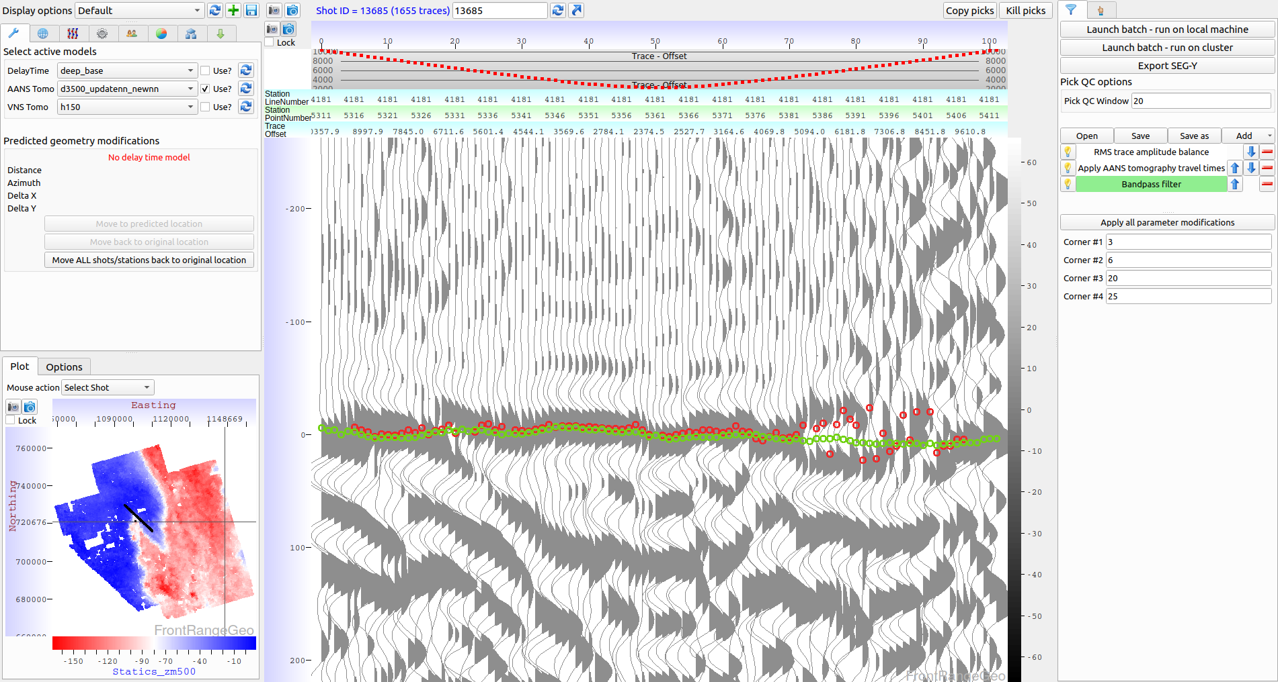
First break pick example – bandpass filter
DeepTrace picks
Human picks

Slide 31
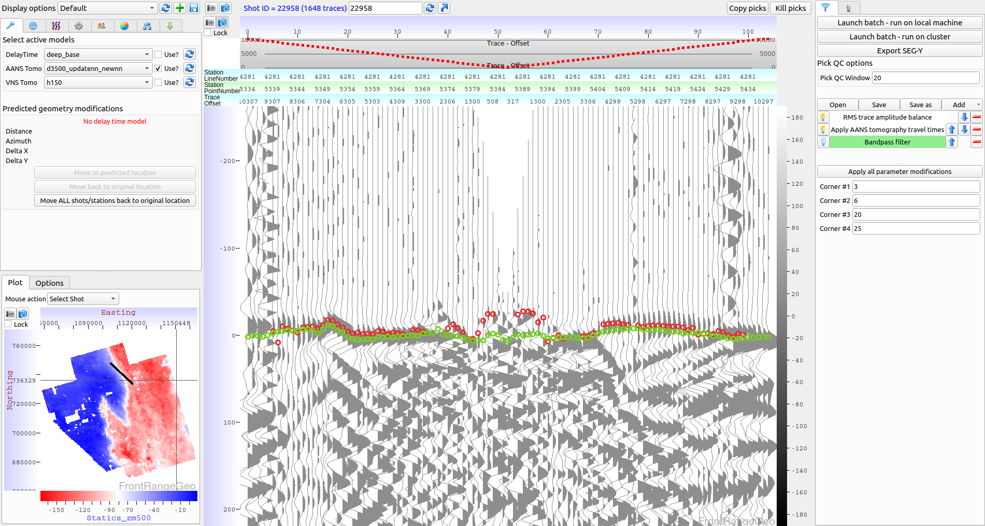
First break pick example
DeepTrace picks
Human picks

Slide 32
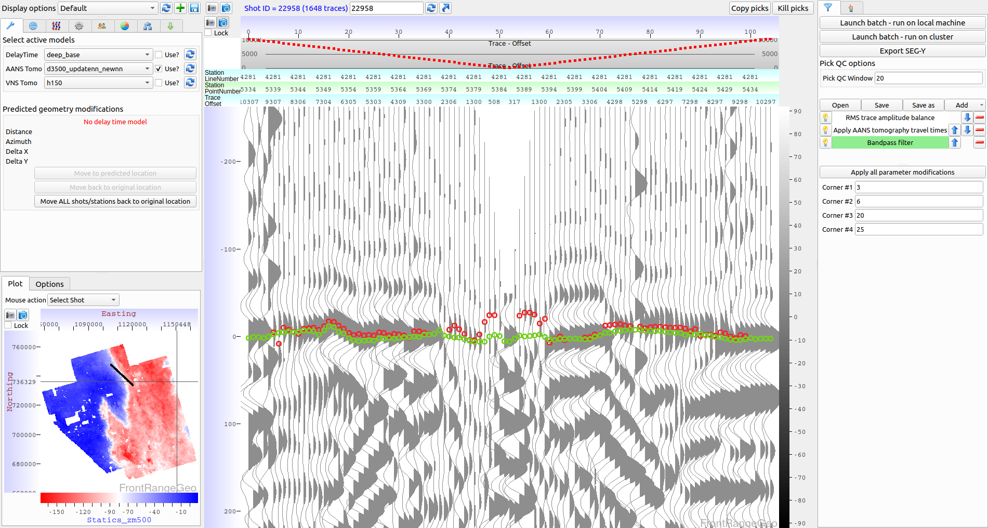
First break pick example – bandpass filter
DeepTrace picks
Human picks

Slide 33
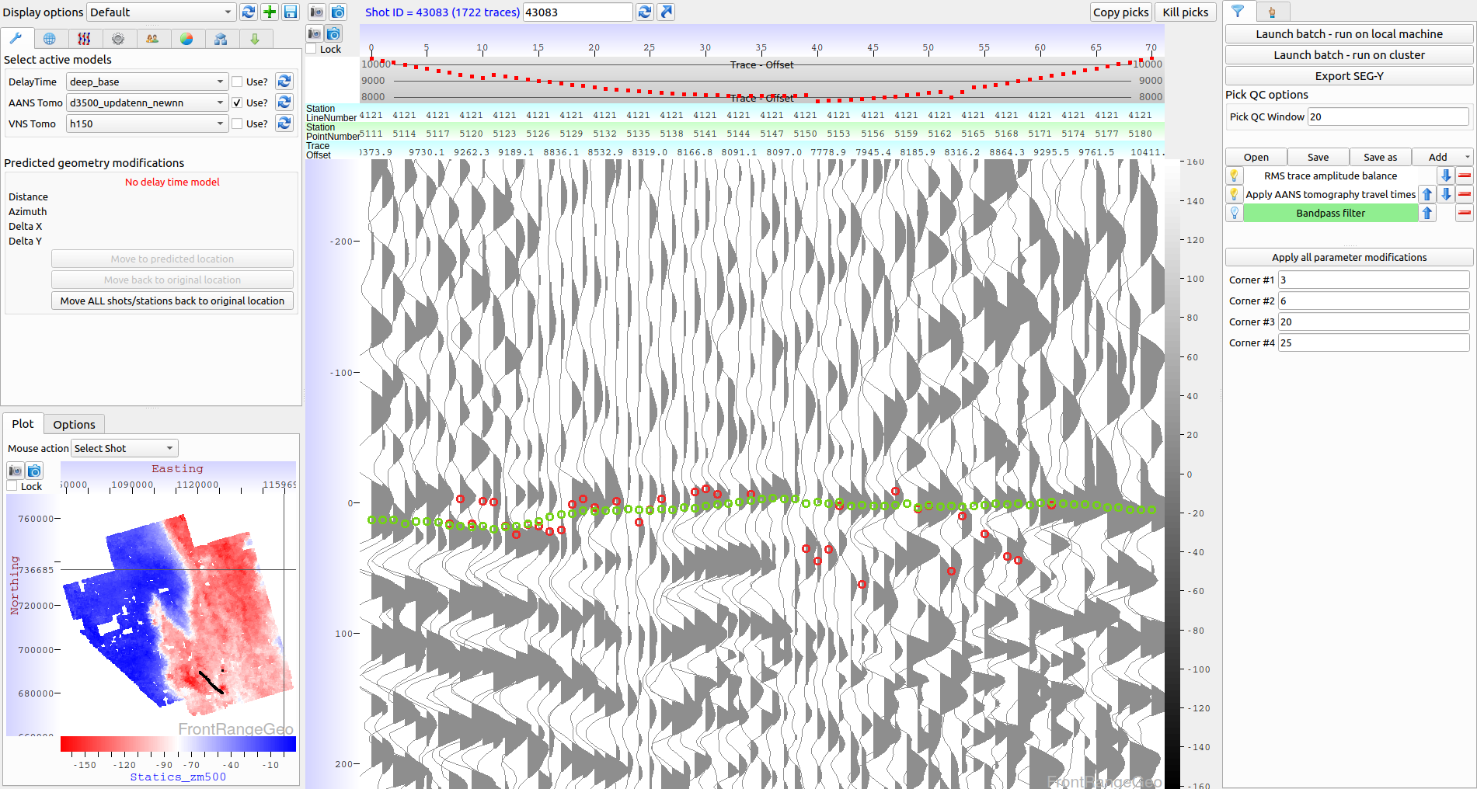
First break pick example
DeepTrace picks
Human picks

Slide 34
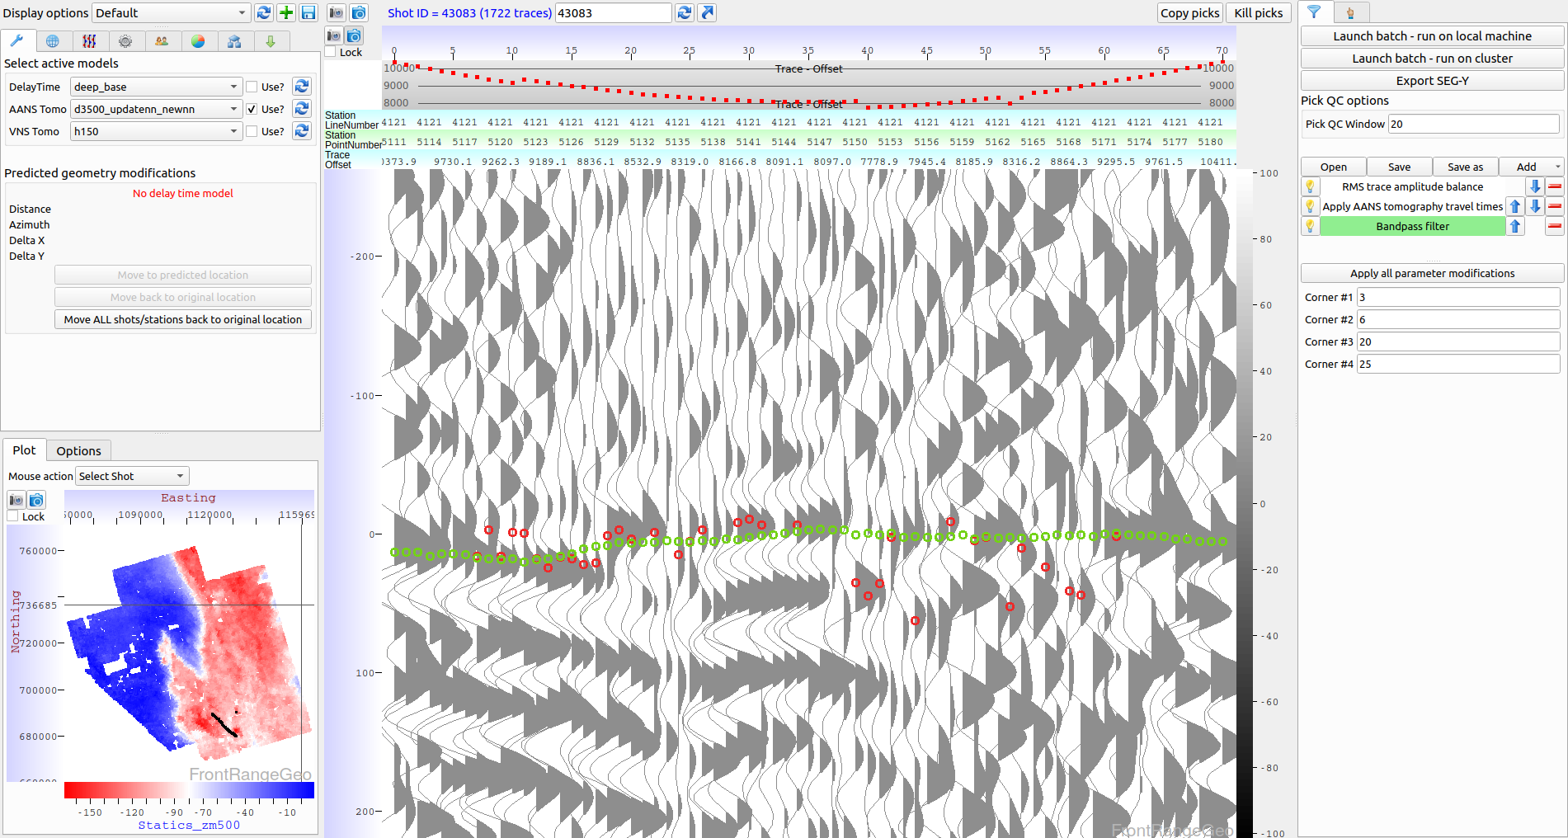
First break pick example – bandpass filter
DeepTrace picks
Human picks

Slide 35
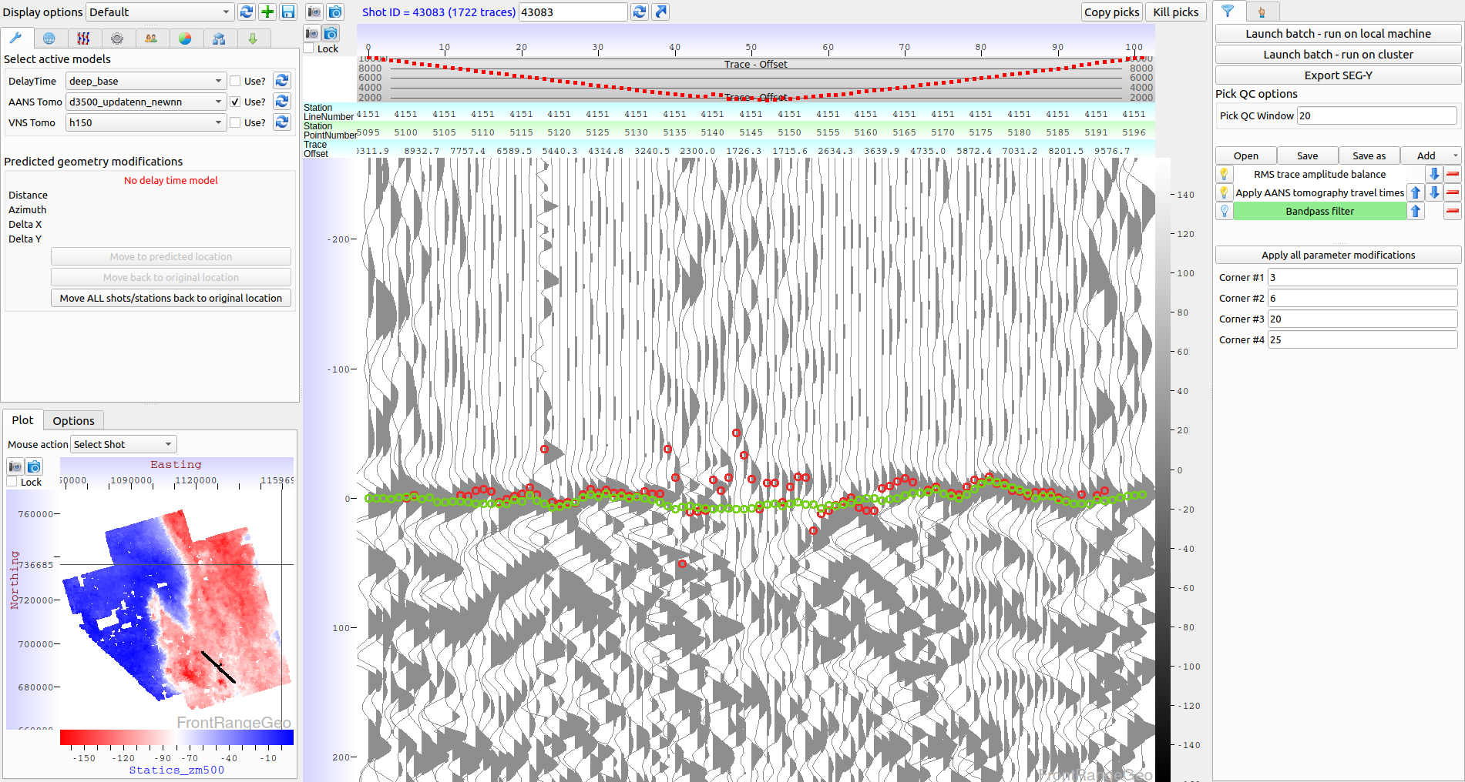
First break pick example
DeepTrace picks
Human picks

Slide 36
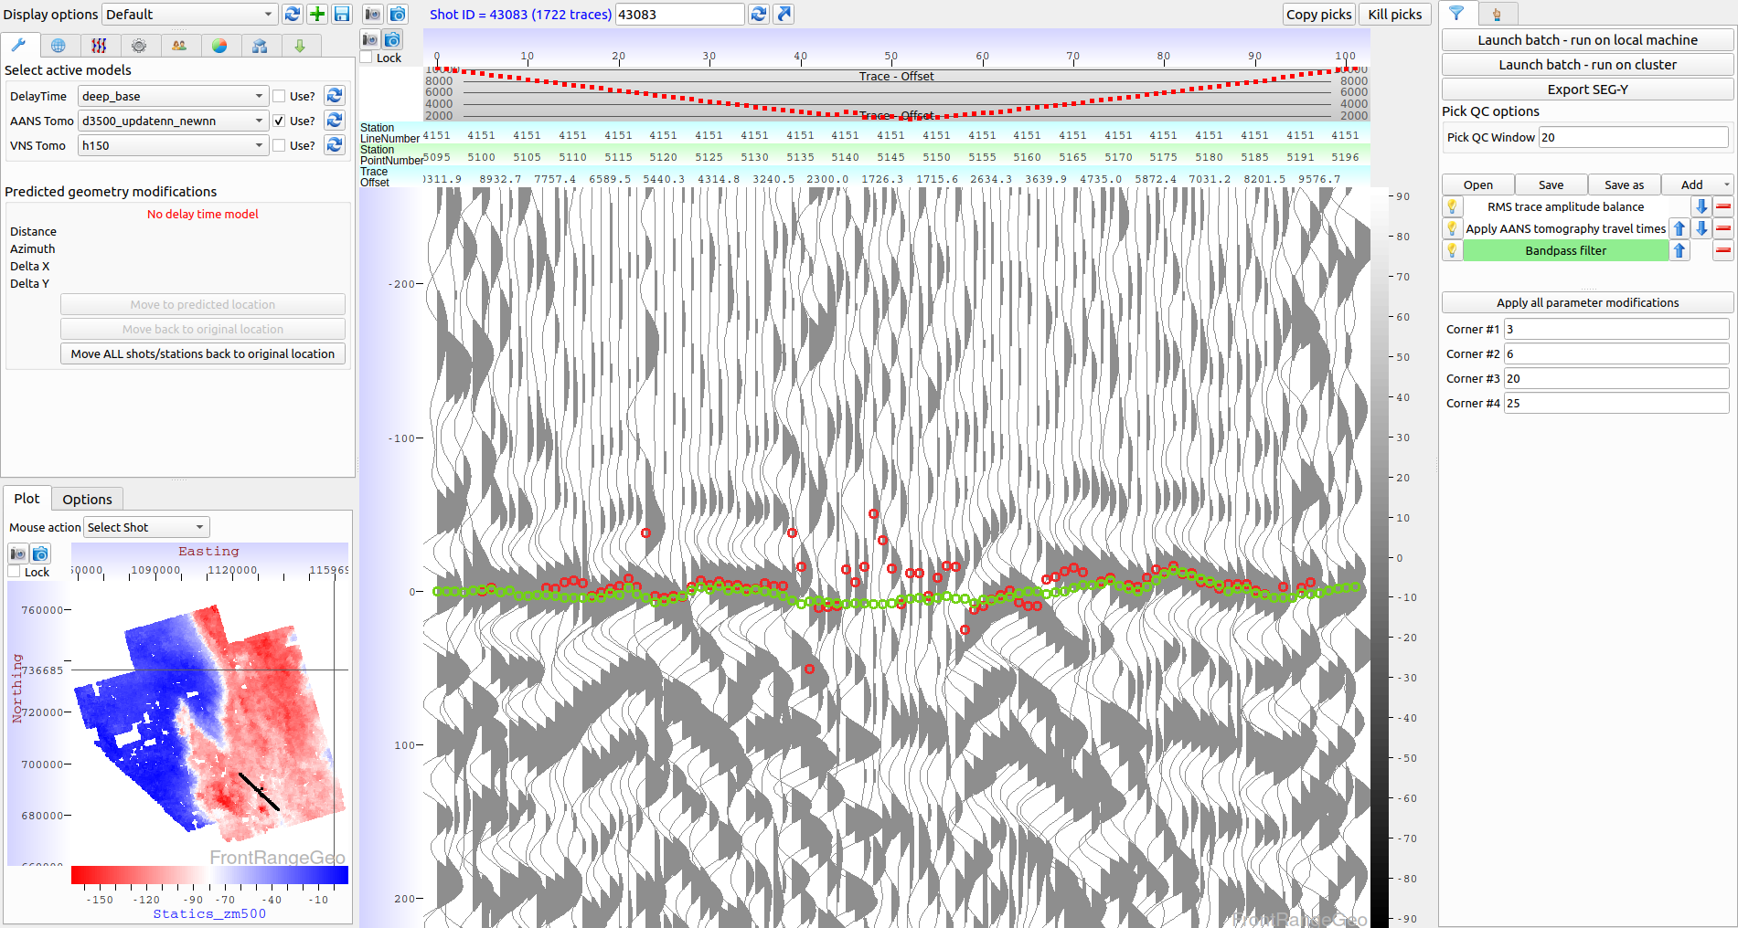
First break pick example – bandpass filter
DeepTrace picks
Human picks

Slide 37
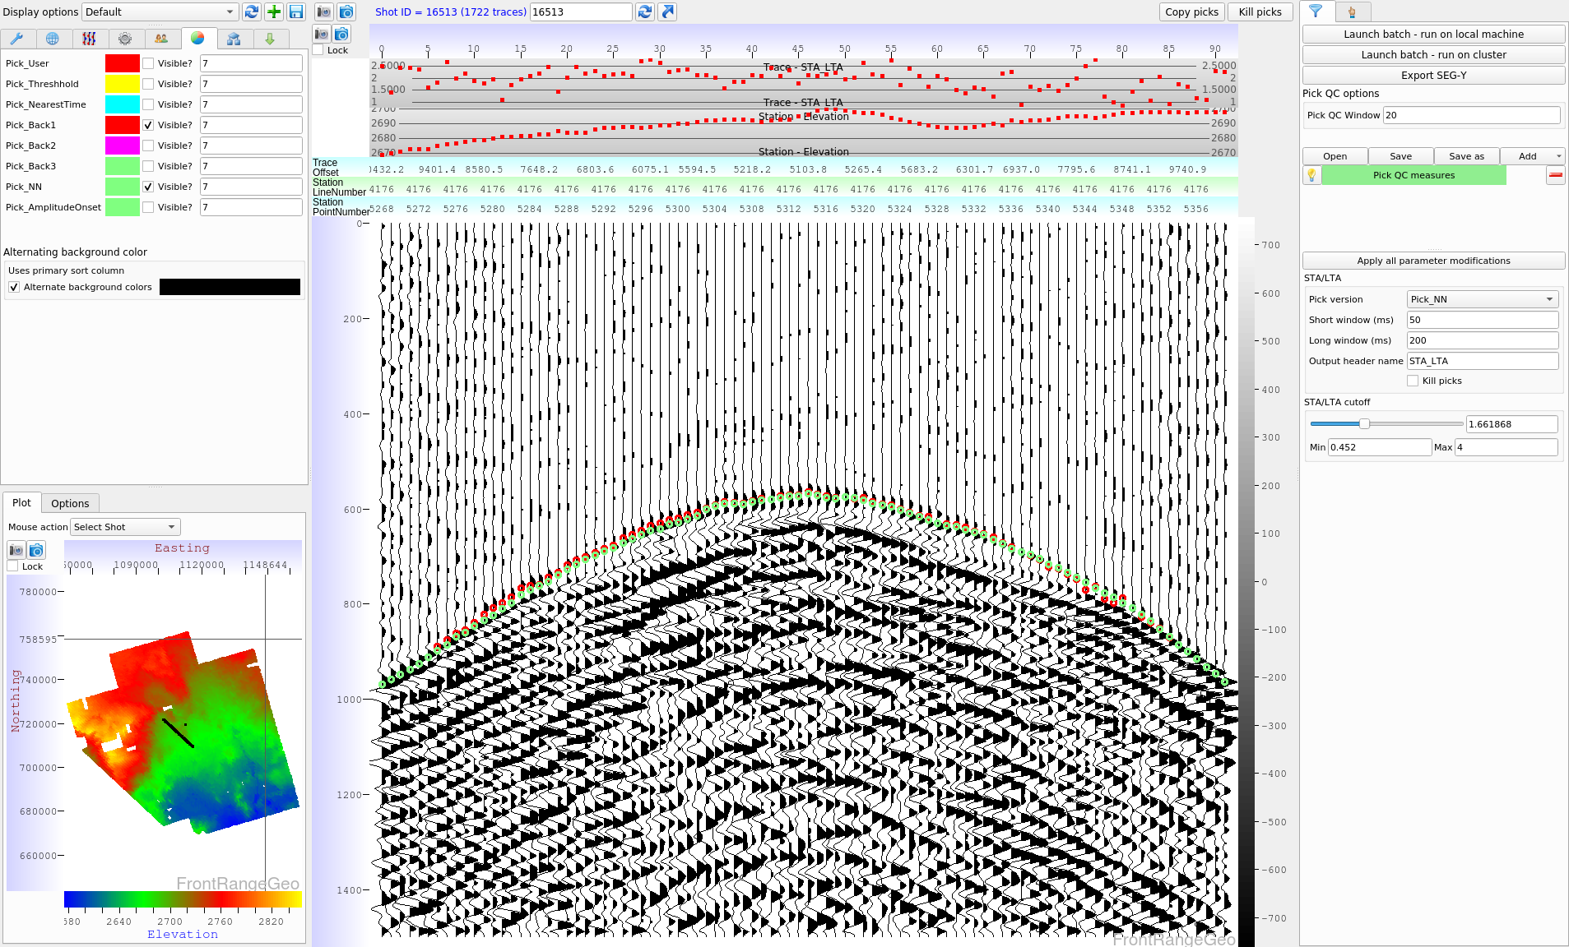
First break pick example – no moveout STA/LTA analysis

Slide 38
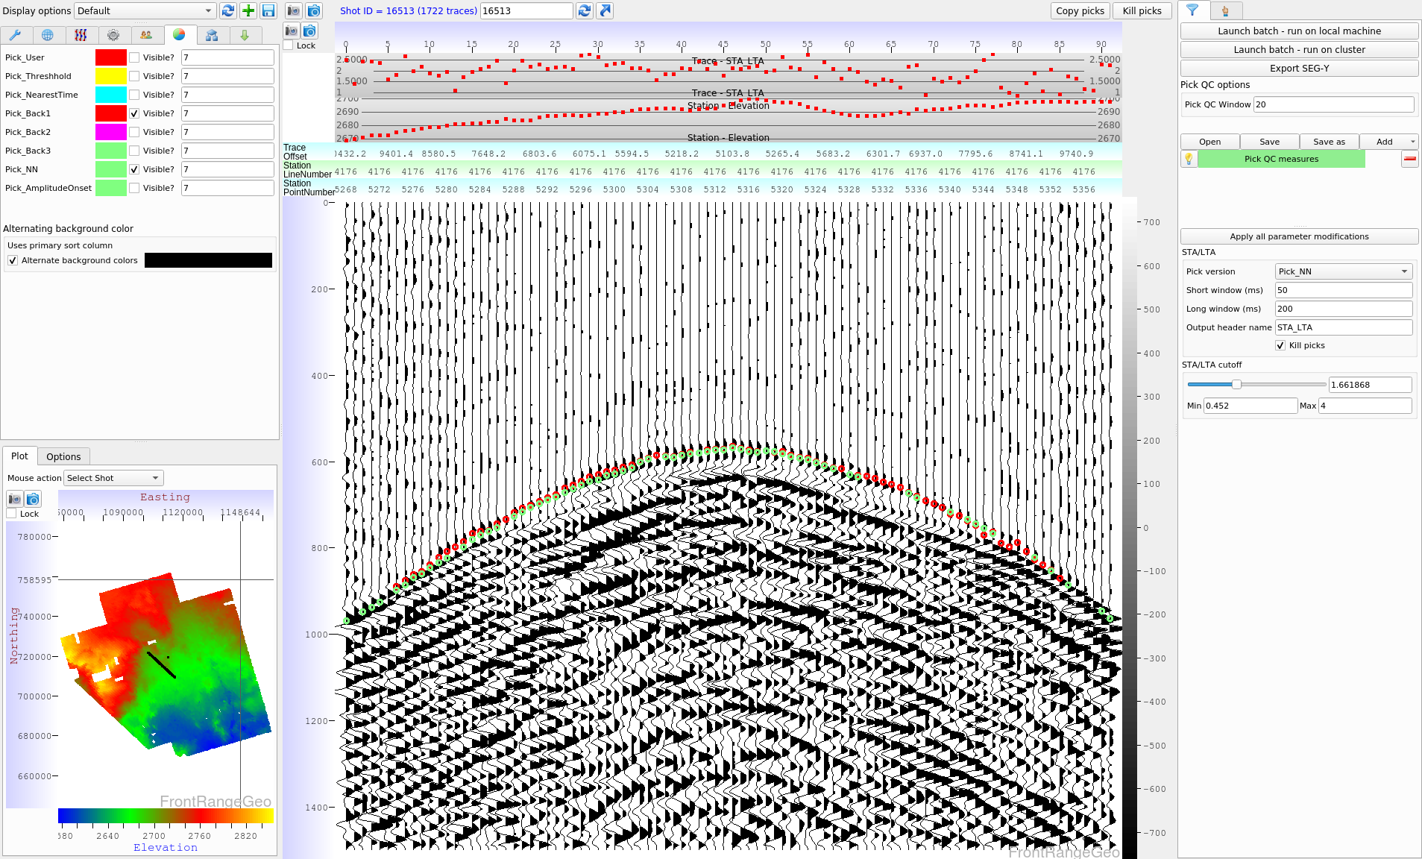
First break pick example – no moveout Picks killed using STA/LTA threshhold

Slide 39
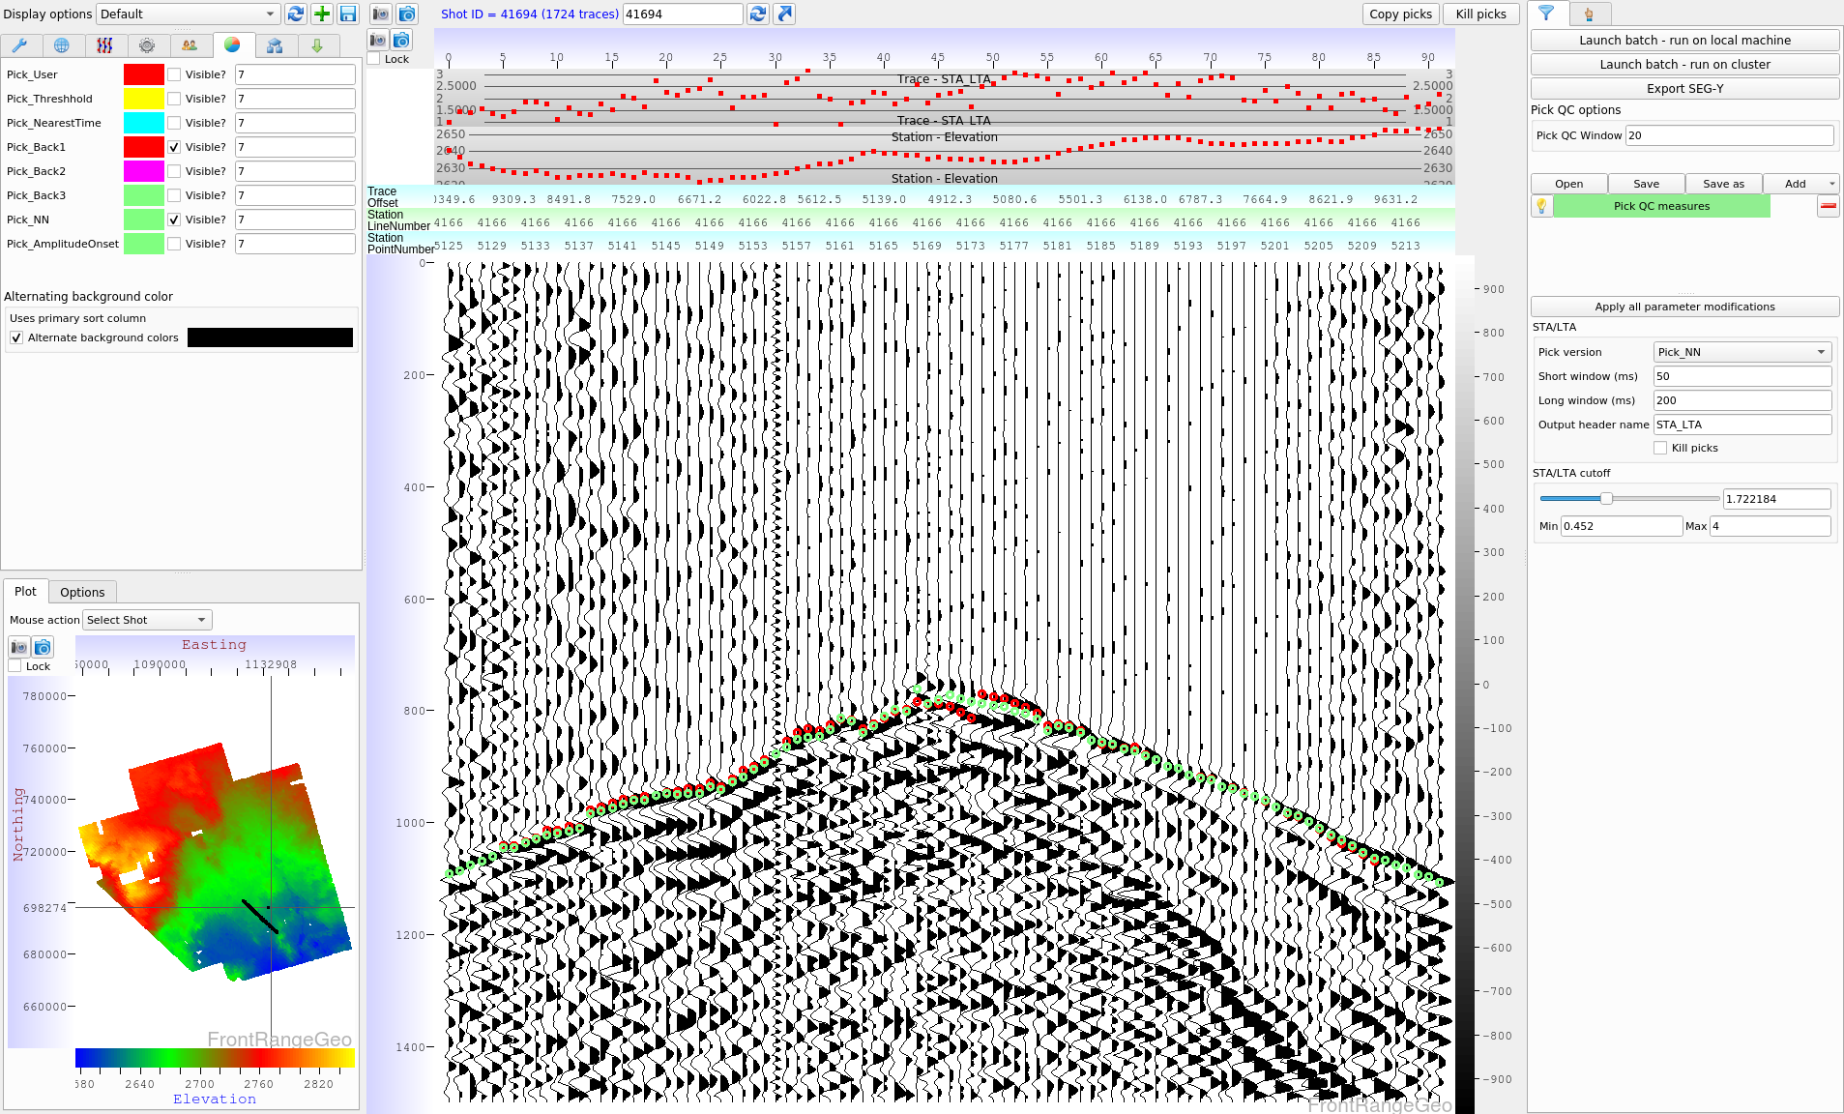
First break pick example – no moveout STA/LTA analysis

Slide 40
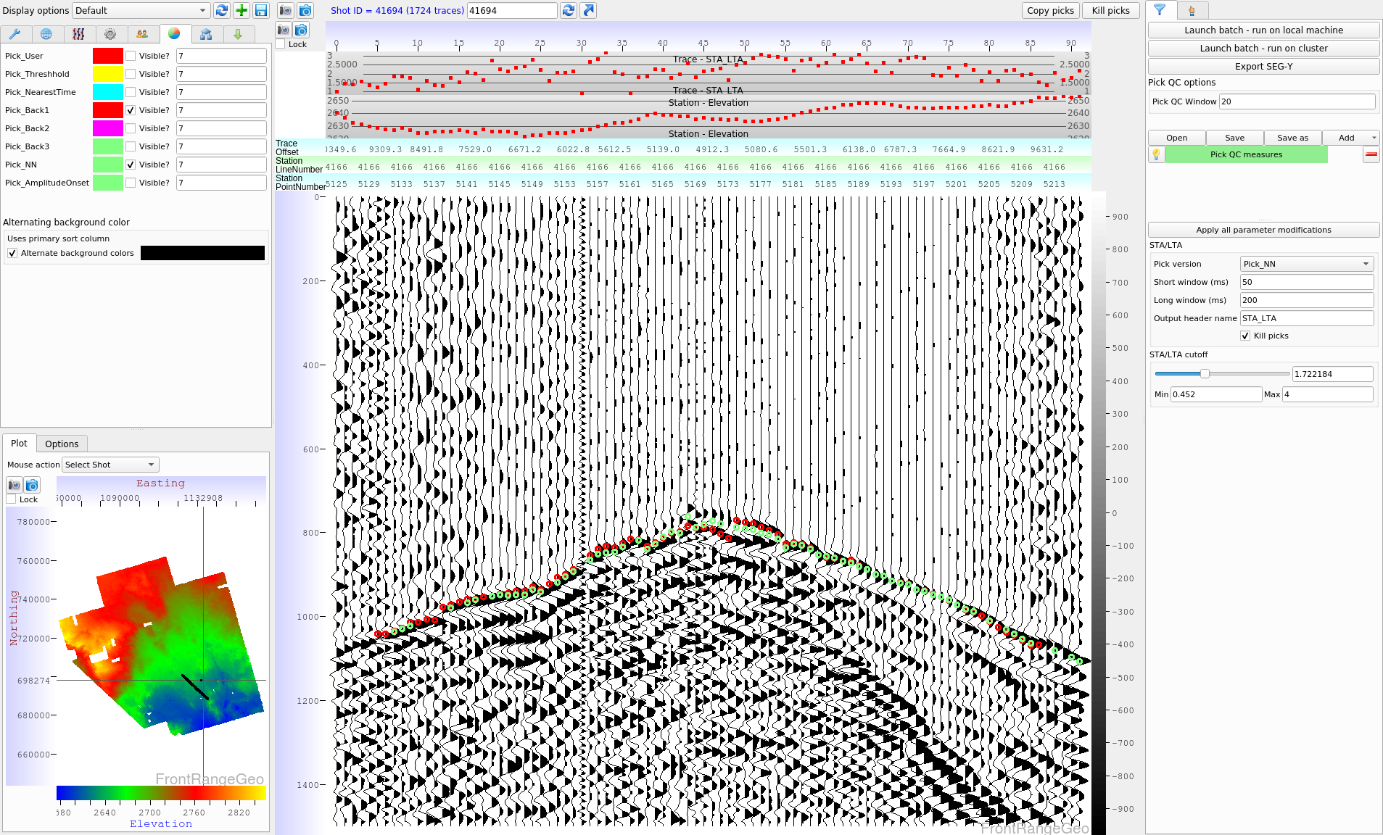
First break pick example – no moveout Picks killed using STA/LTA threshhold

Slide 41
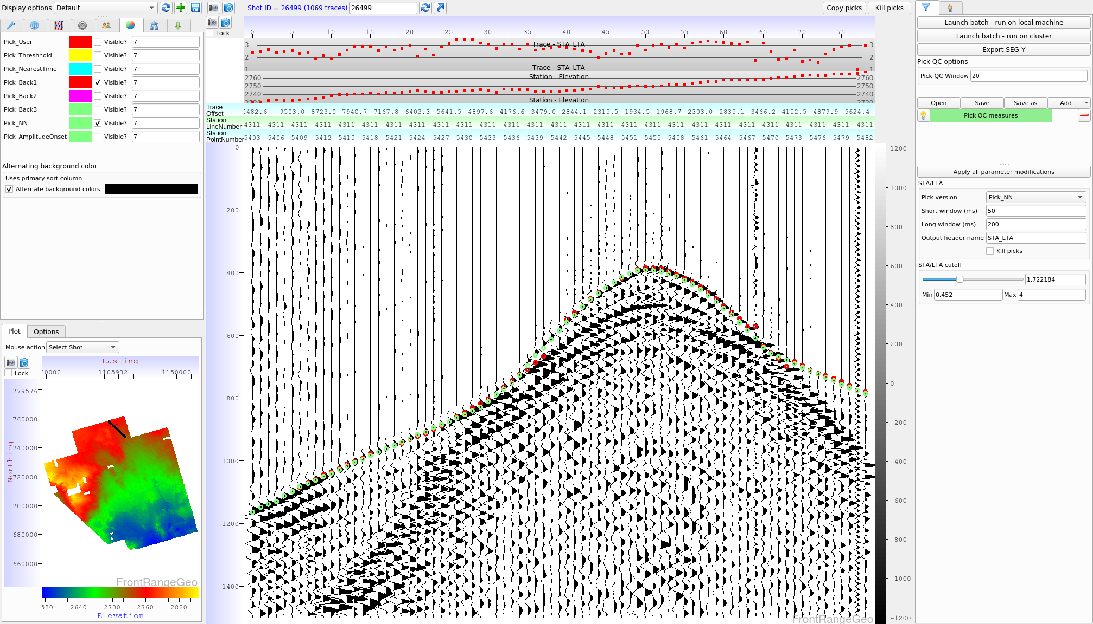
First break pick example – no moveout STA/LTA analysis

Slide 42
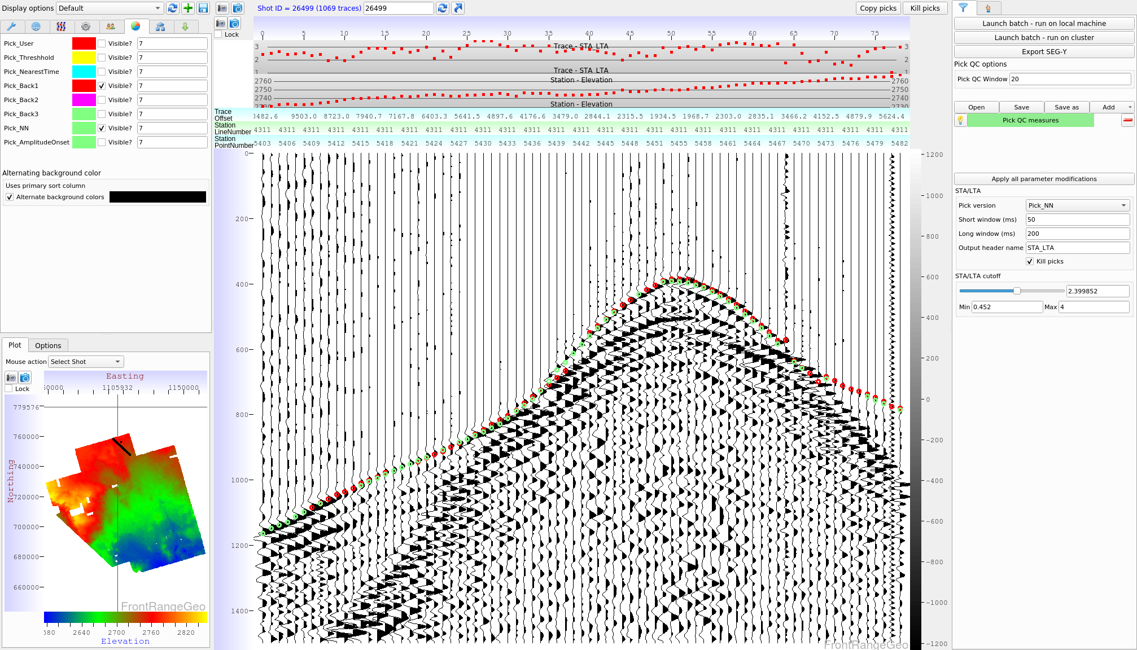
First break pick example – no moveout Picks killed using STA/LTA threshhold

Slide 43
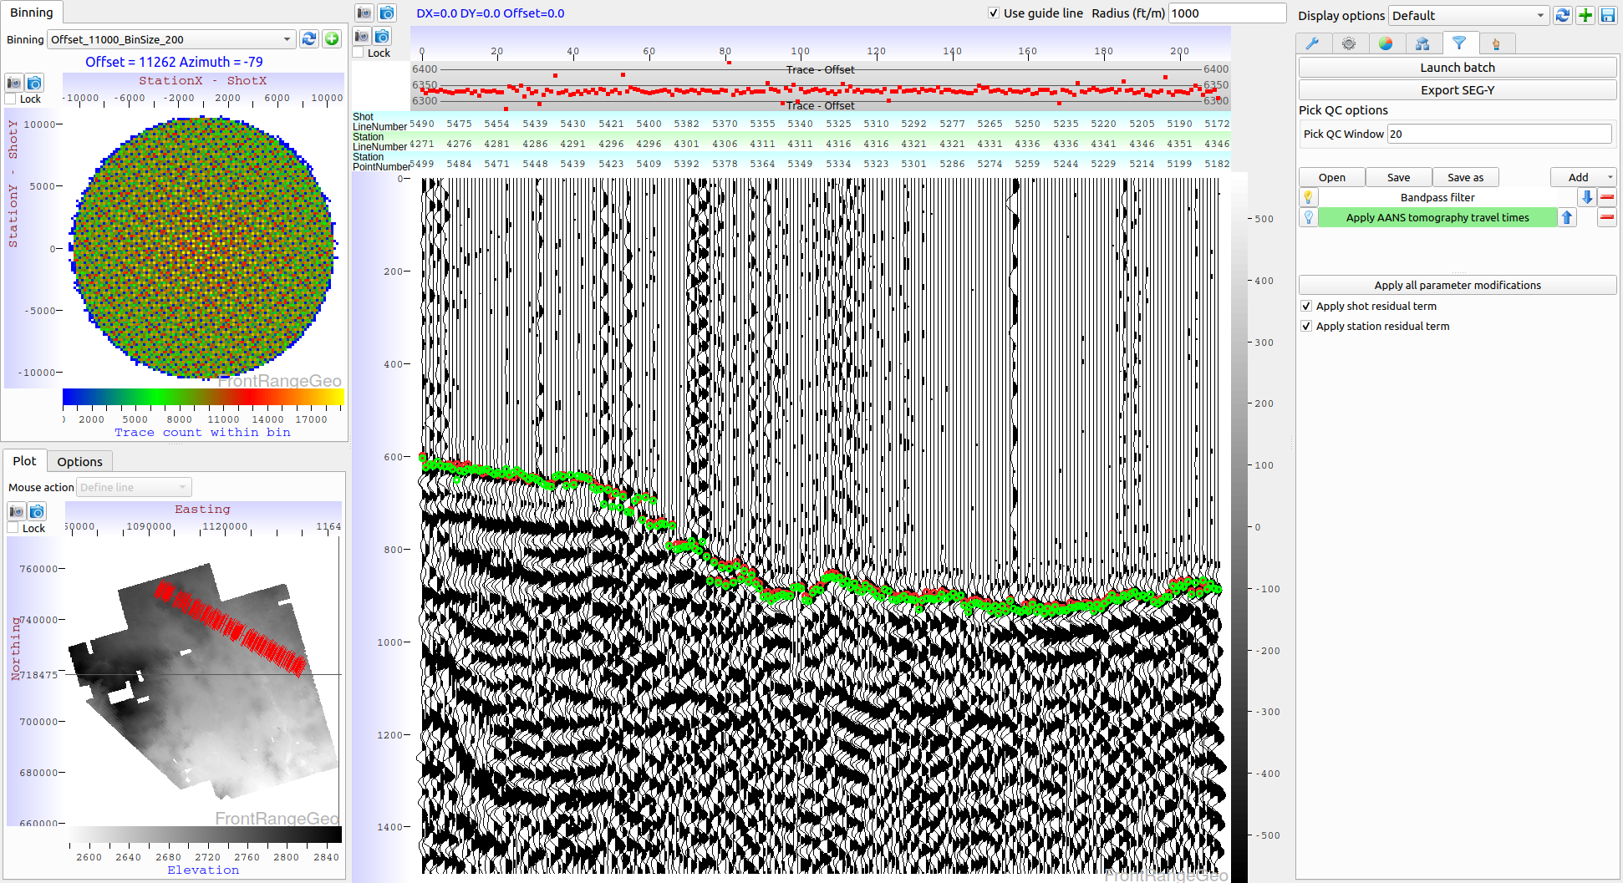
Offset plane picker (DX-DY) – Tomography not applied
DeepTrace picks
Human picks

Slide 44
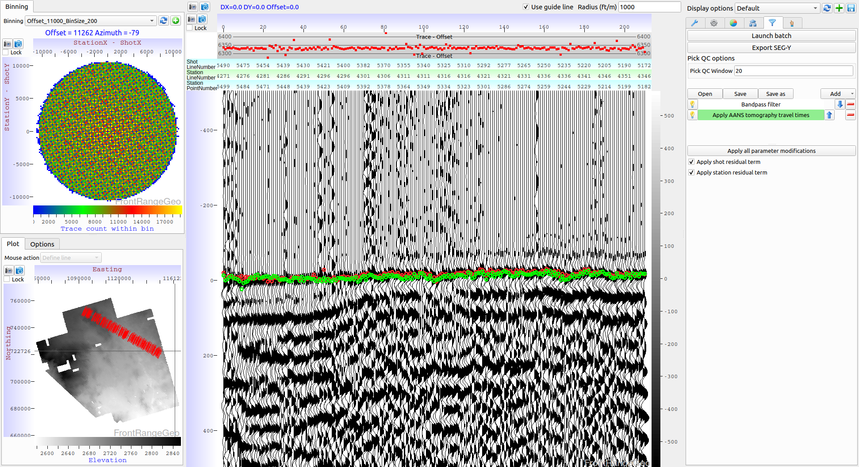
Offset plane picker (DX-DY) – Tomography applied
DeepTrace picks
Human picks

Slide 45
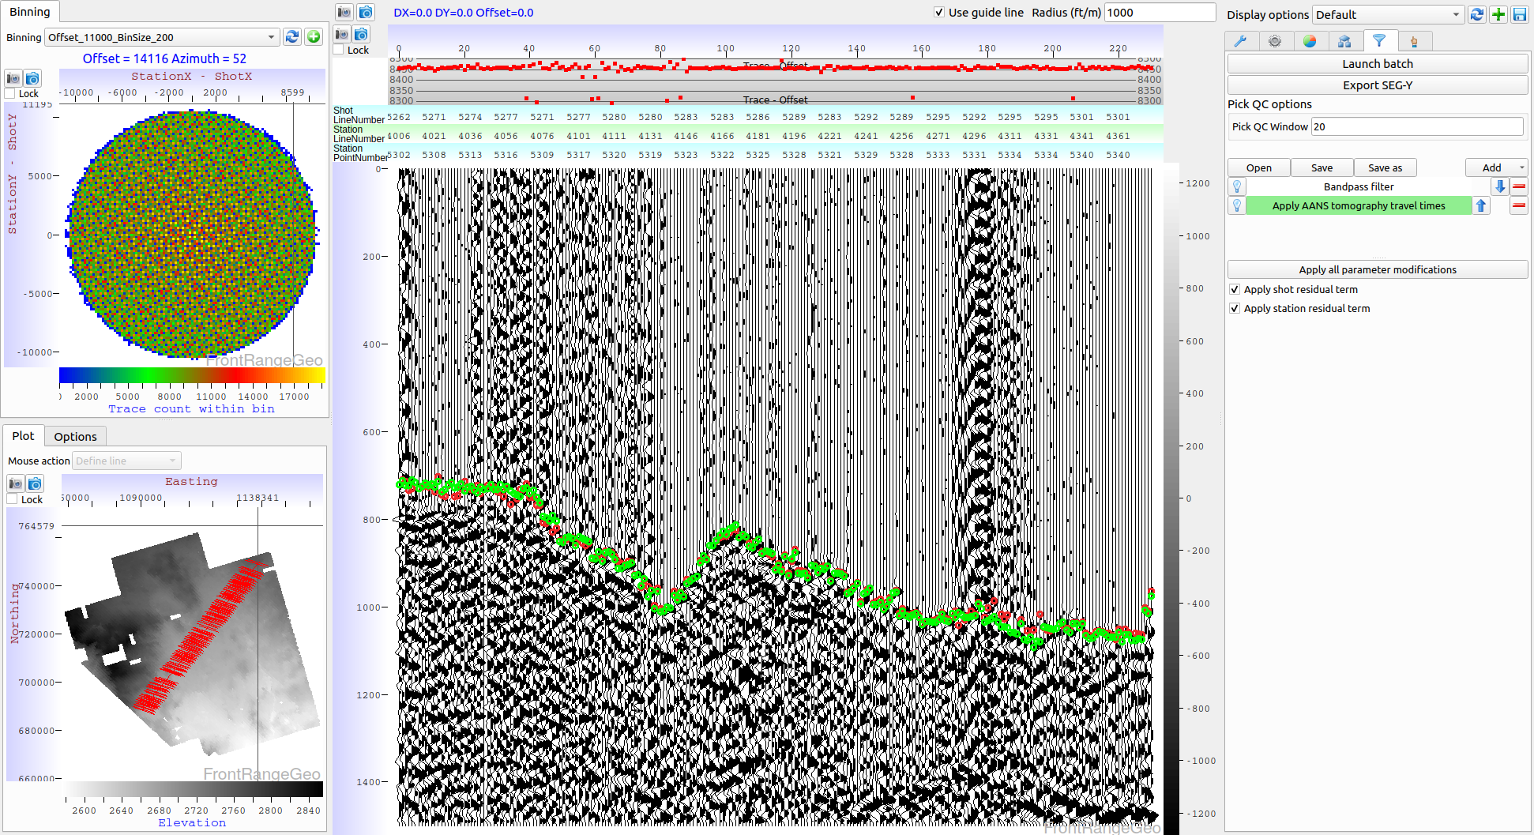
Offset plane picker (DX-DY) – Tomography not applied
DeepTrace picks
Human picks

Slide 46
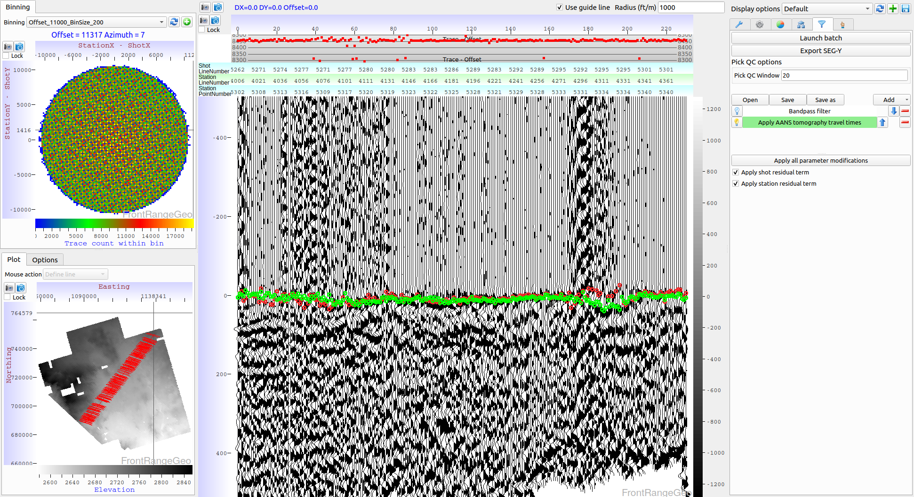
Offset plane picker (DX-DY) – Tomography applied
DeepTrace picks
Human picks

Slide 47
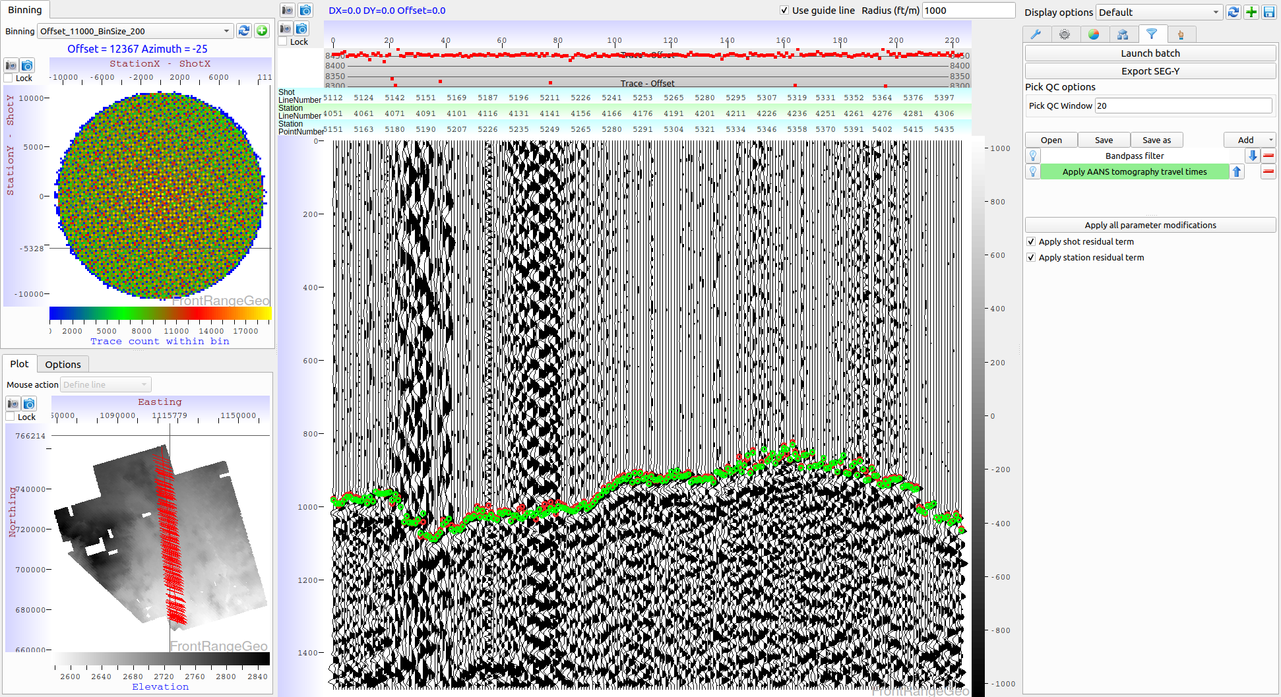
Offset plane picker (DX-DY) – Tomography not applied
DeepTrace picks
Human picks

Slide 48
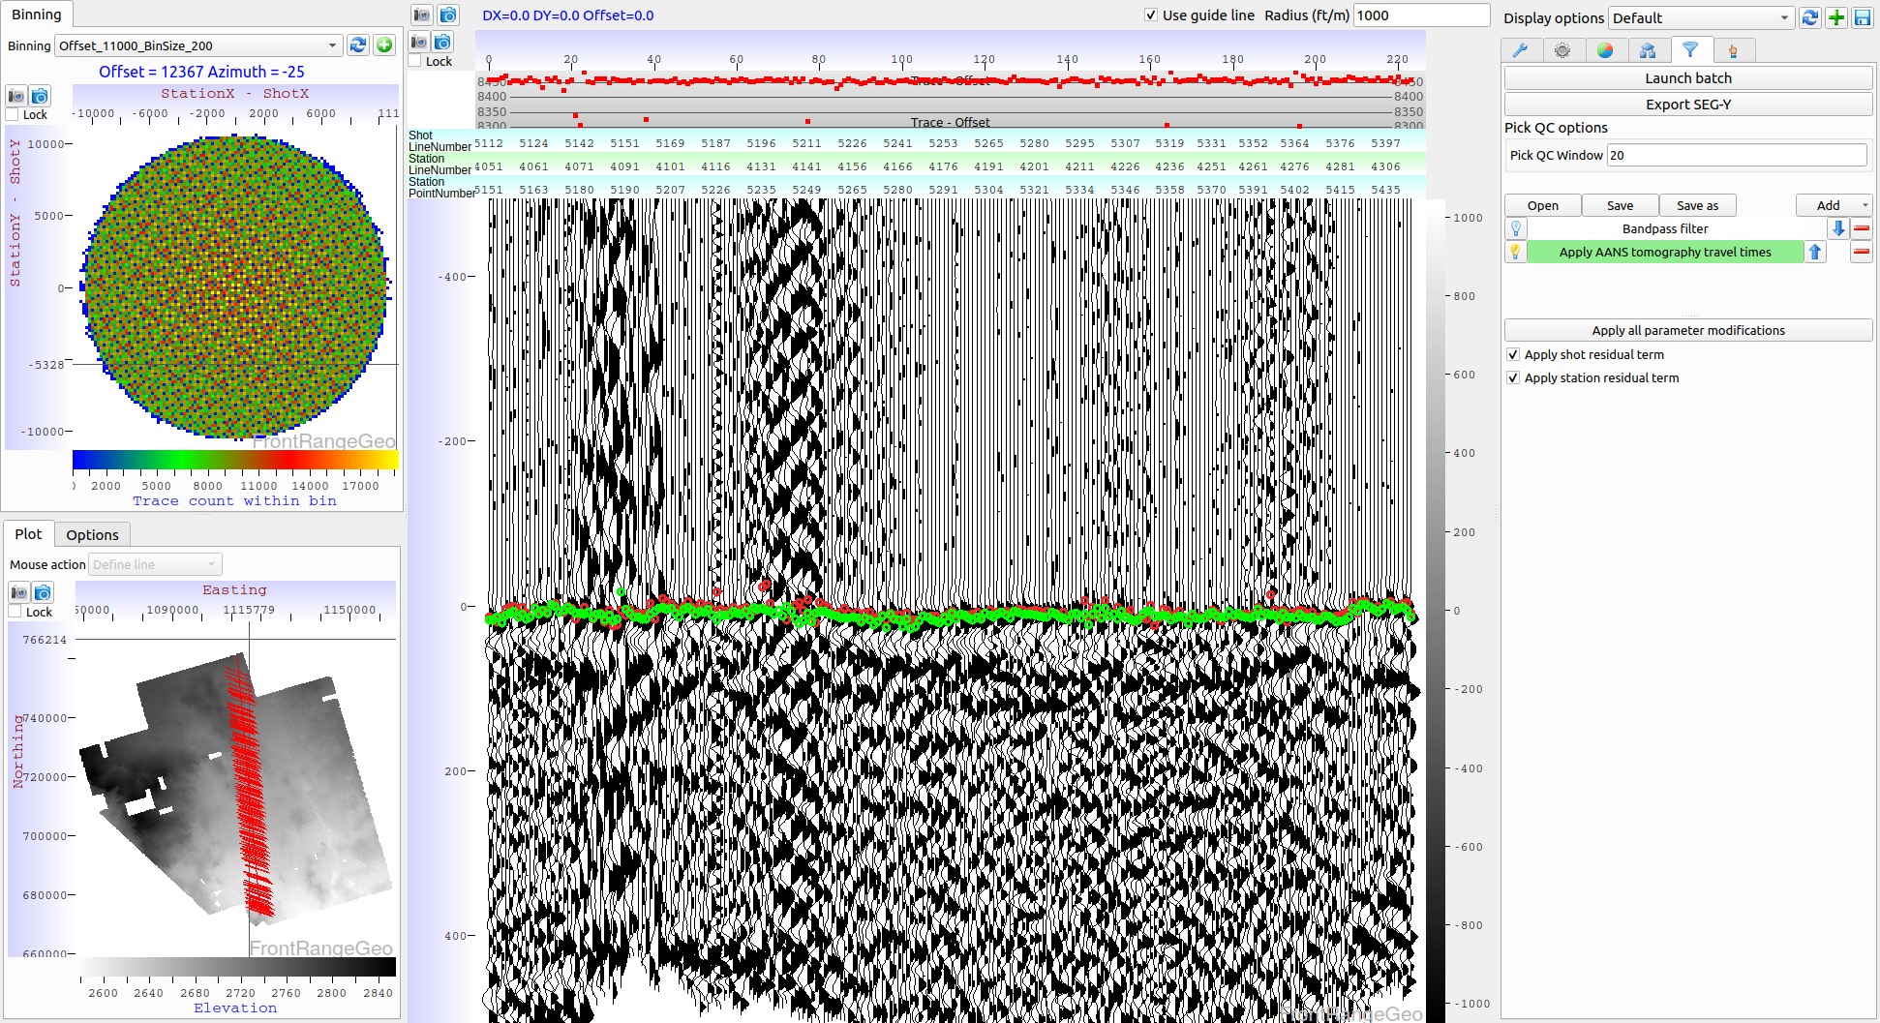
Offset plane picker (DX-DY) – Tomography applied
DeepTrace picks
Human picks

Slide 49
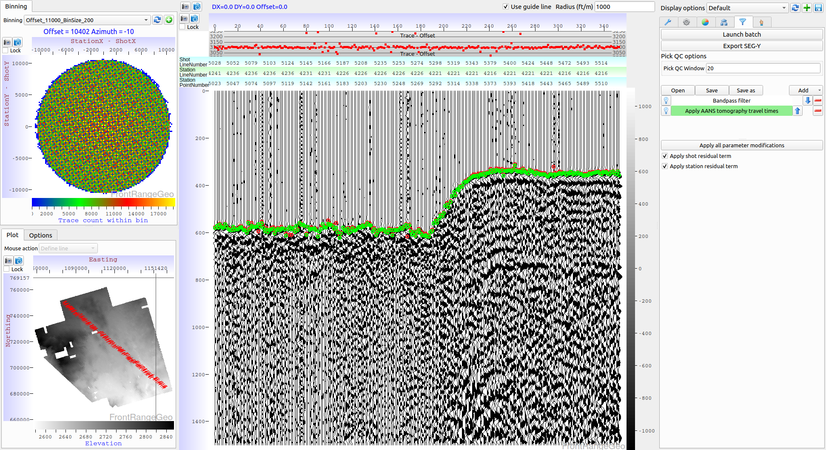
Offset plane picker (DX-DY) – Tomography not applied
DeepTrace picks
Human picks

Slide 50
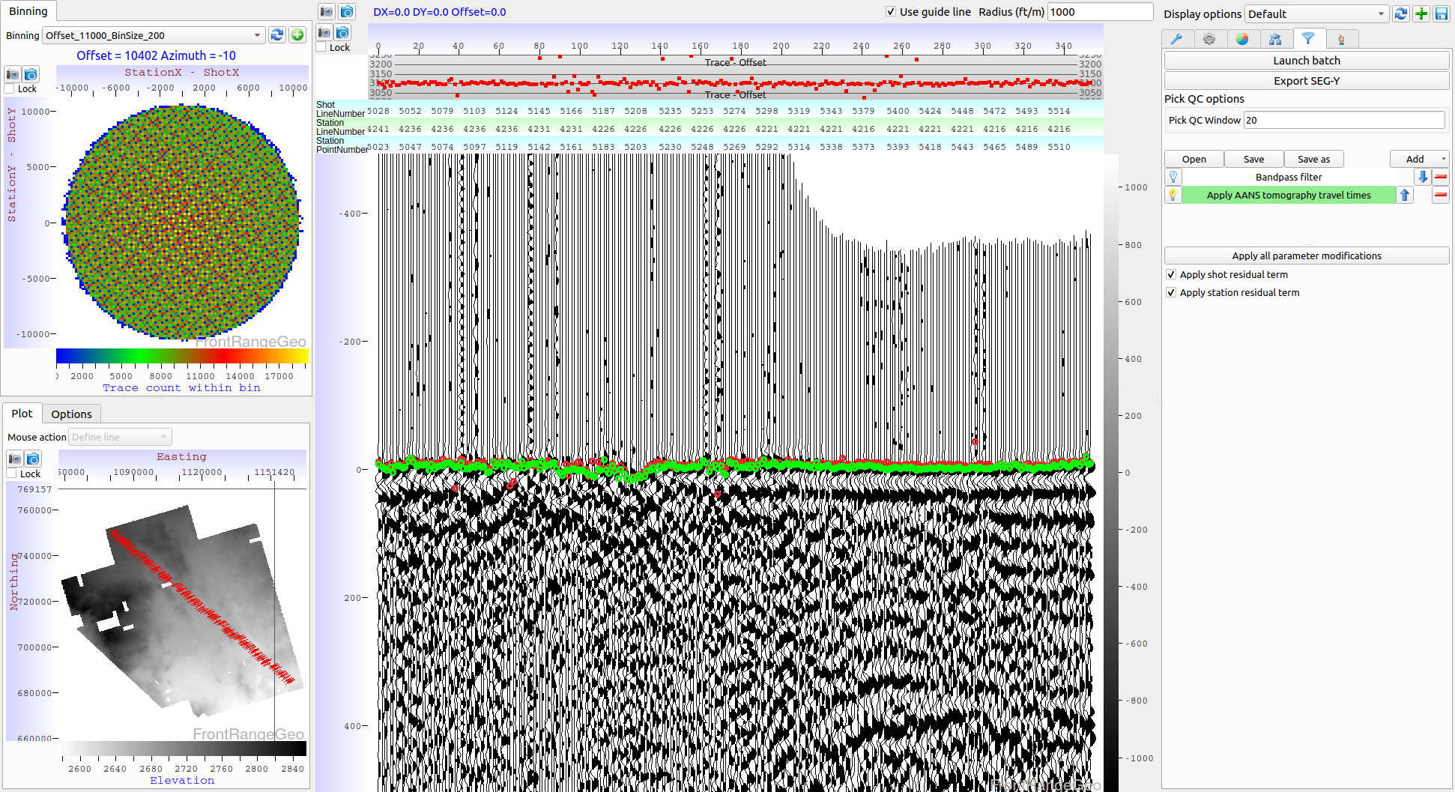
Offset plane picker (DX-DY) – Tomography applied
DeepTrace picks
Human picks

Slide 51
Pattern recognition picking technology
New technology is under development to assist picking in very noisy areas
The technology is intended to mimic human ability to “see” through complicated areas
Examples follow

Slide 52
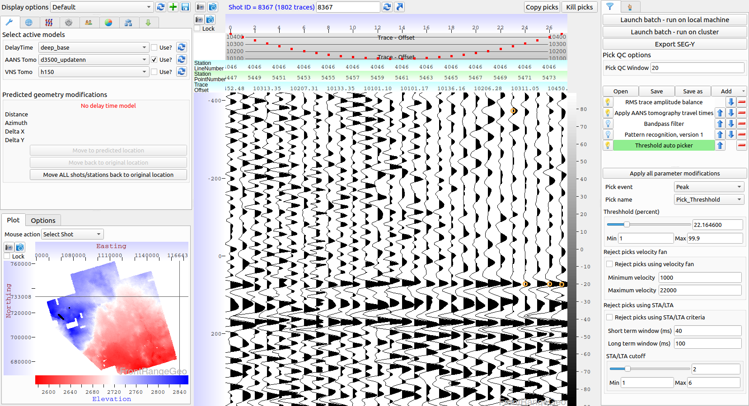
Pattern recognition example #1 NOT applied

Slide 53
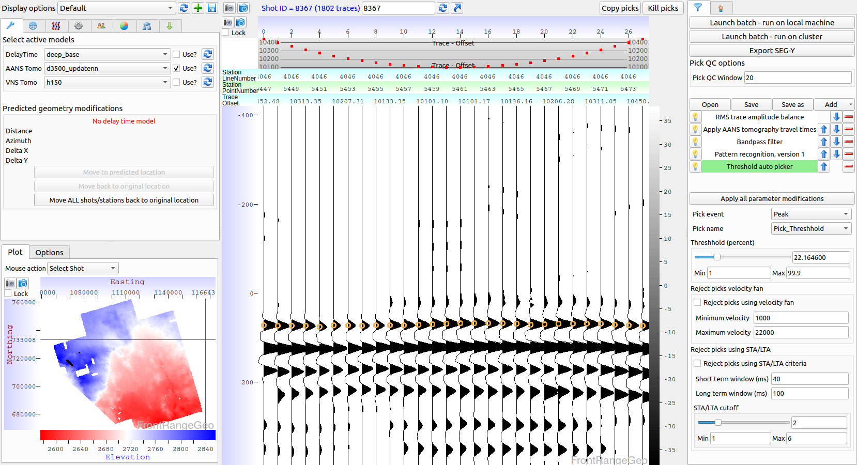
Pattern recognition example #1 Applied

Slide 54
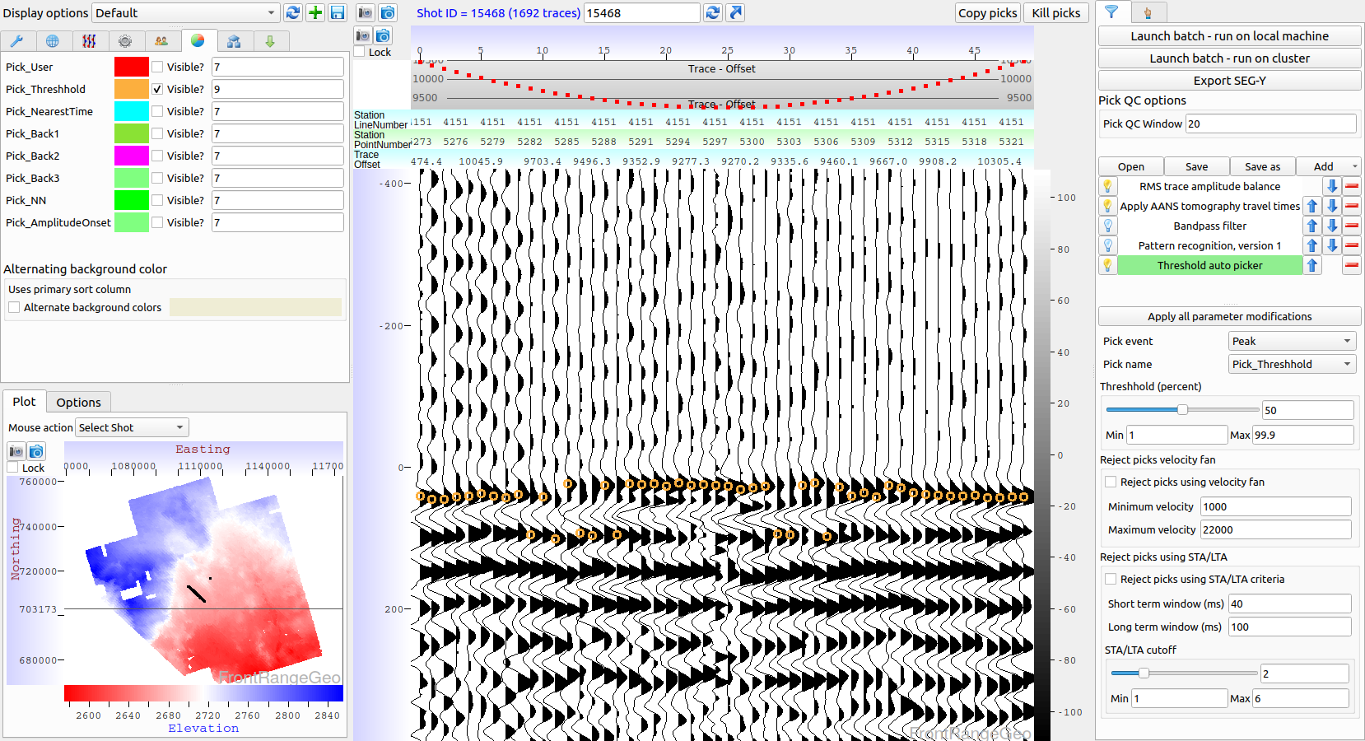
Pattern recognition example #2 NOT applied

Slide 55
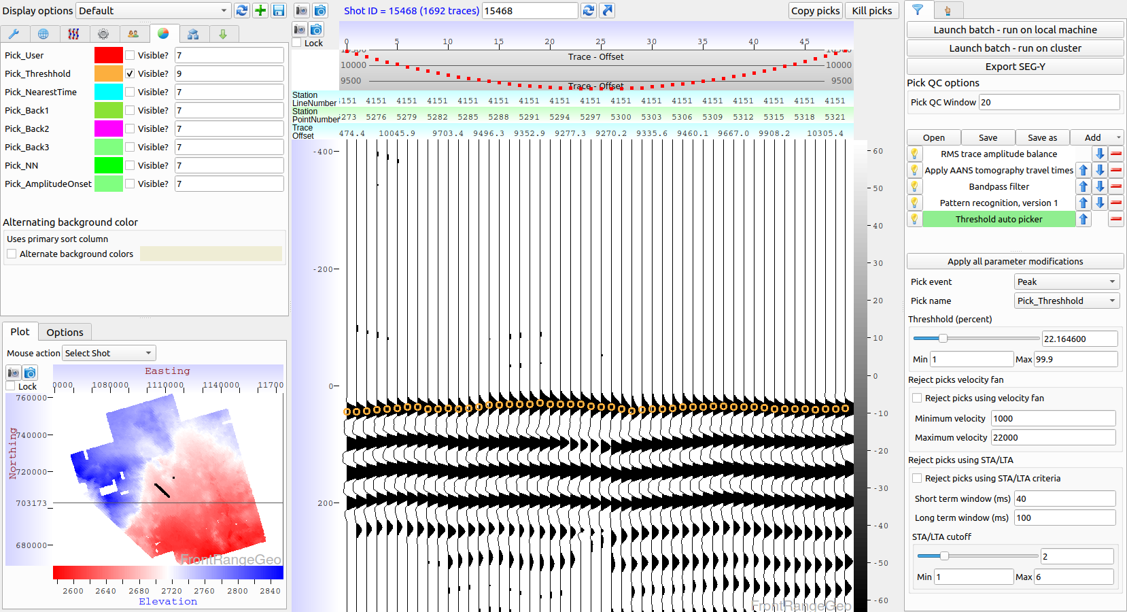
Pattern recognition example #2 Applied

Slide 56
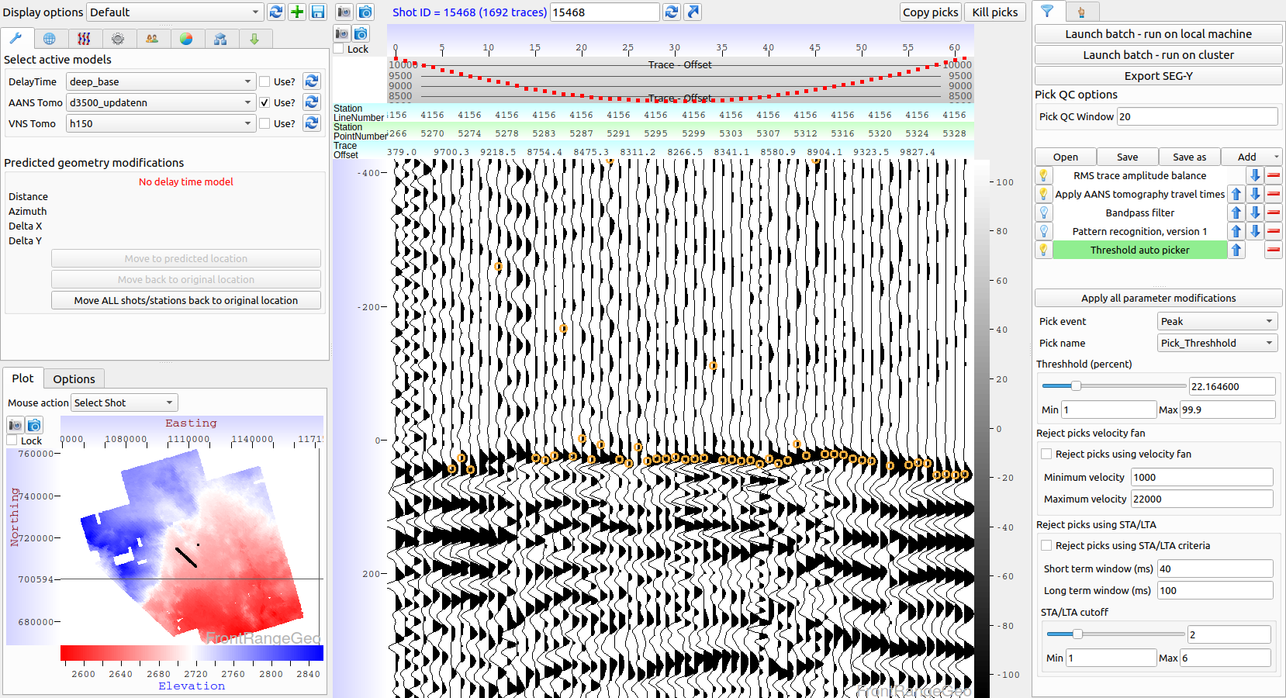
Pattern recognition example #3 NOT applied

Slide 57
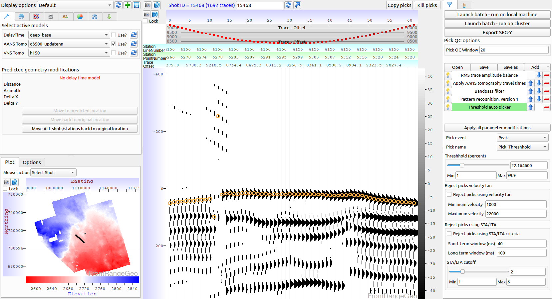
Pattern recognition example #3 Applied

Slide 58
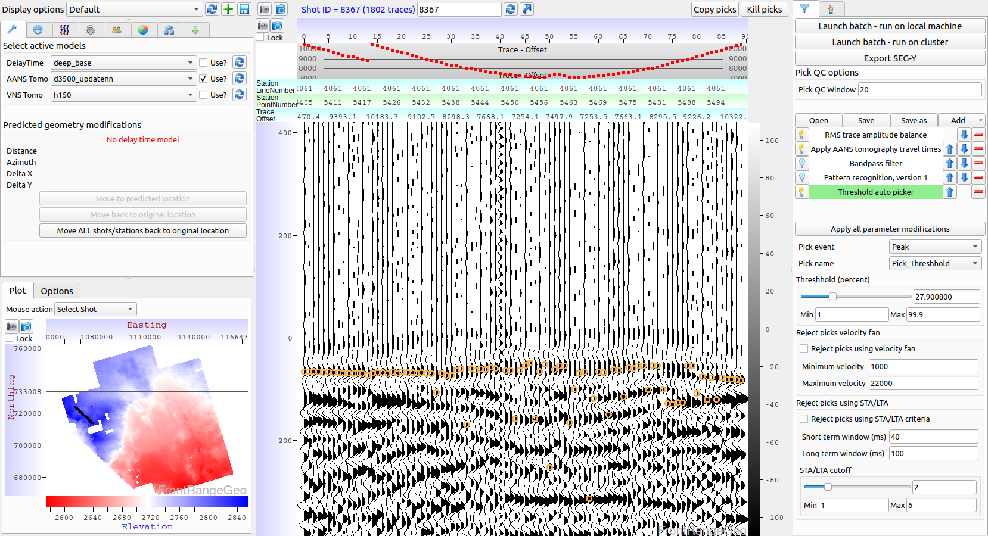
Pattern recognition example #4 NOT applied

Slide 59
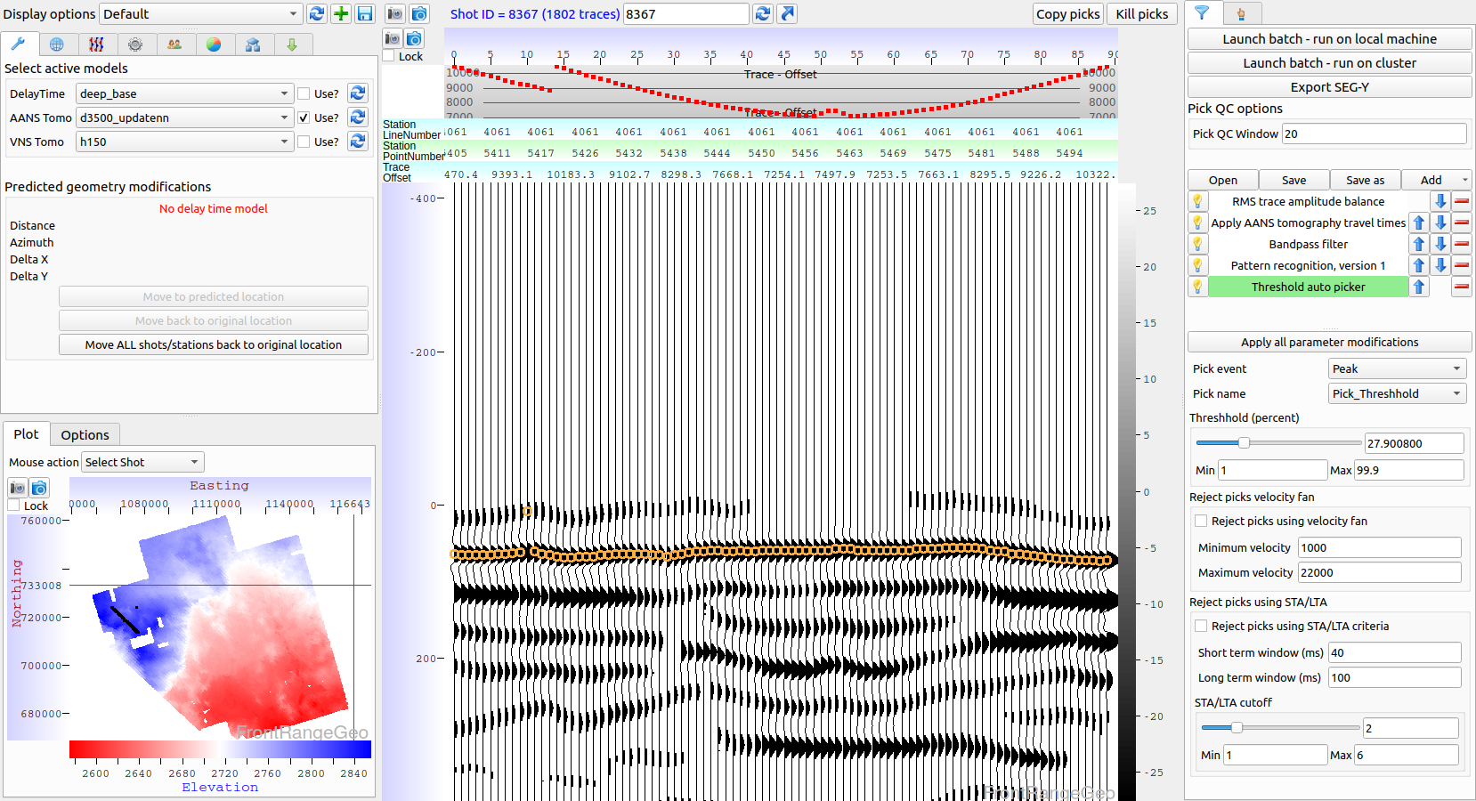
Pattern recognition example #4 Applied

Slide 60
Near surface modeling
Phoenix currently has three approaches:
Delay time solution. Usually provides good statics, essential for geometry QC
VNS (variable node spacing) tomography. The industry standard approach
ANS (adaptive node spacing) tomography. A new approach designed to better delineate refractor boundaries and velocity inversions

Slide 61
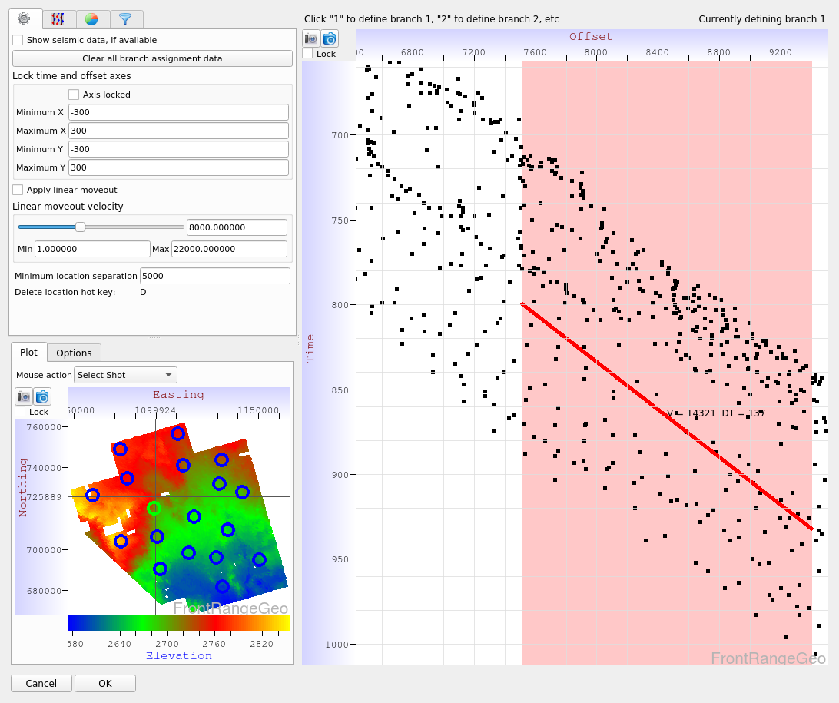
Delay time analysis – branch assignment

Slide 62
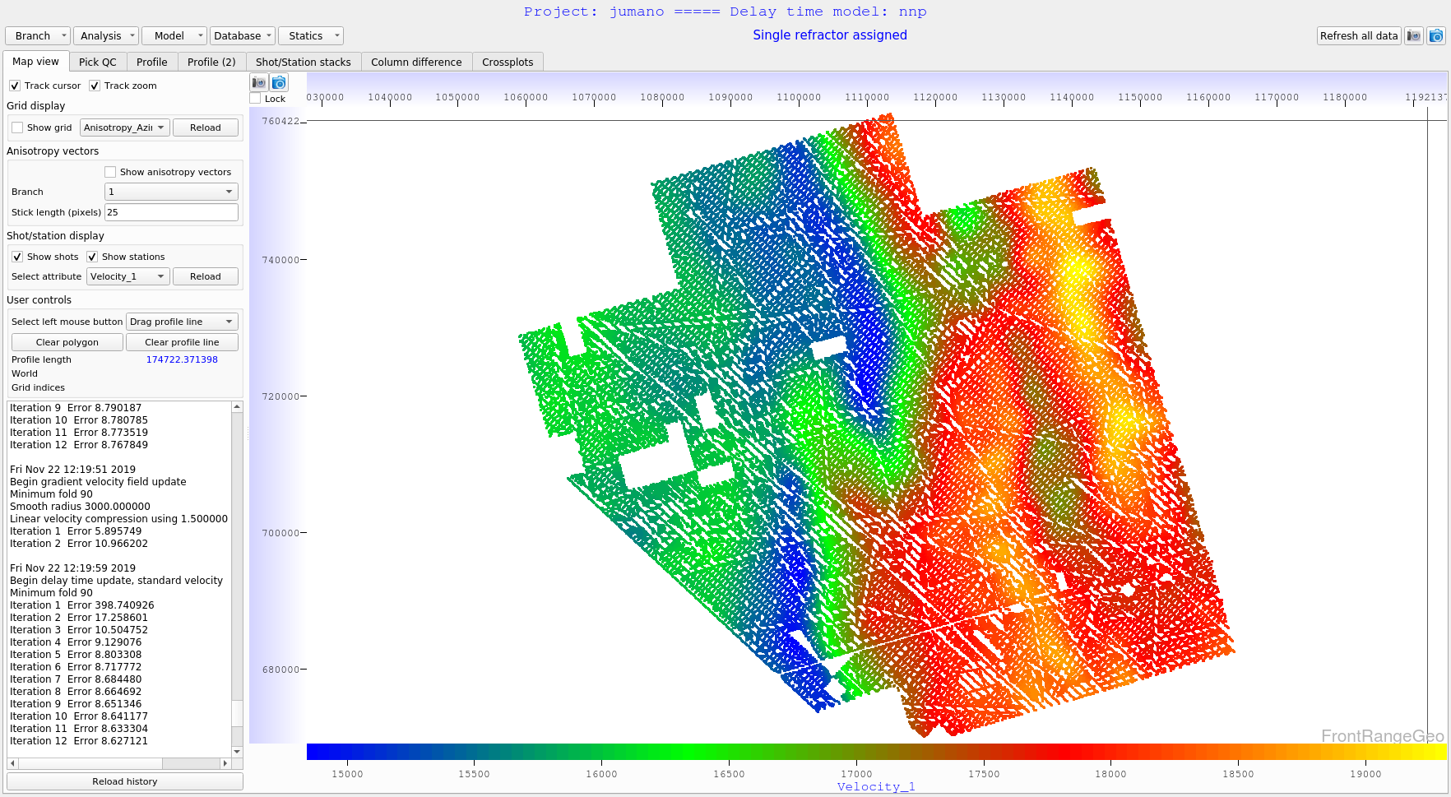
Delay time analysis – refractor velocity

Slide 63

Delay time analysis – delay times

Slide 64

Delay time analysis - profile

Slide 65

Delay time analysis – shot/station stacks

Slide 66
Adaptive Node Spacing (ANS) Tomography
Node spacing is modified on the fly to minimize travel time errors through the model
The algorithm results in better refractor boundary resolution, and usually does a better job detecting velocity inversions
The following model has 120 foot horizontal node spacing and 40 foot vertical node spacing – again, the vertical node spacing is modified on the fly for each shot.

Slide 67

ANS tomography – velocity at surface

Slide 68

ANS tomography – velocity at 500 ft depth

Slide 69

ANS tomography – velocity at 1000 ft depth

Slide 70

ANS tomography – velocity at 1500 ft depth

Slide 71

ANS tomography – velocity at 2500 ft depth

Slide 72


ANS tomography – vertical profile
The lower plot shows node hit count, an indicator of
refractor boundaries

Slide 73


ANS tomography – vertical profile
The lower plot shows node hit count, an indicator of
refractor boundaries

Slide 74

ANS tomography – pick QC display
The red picks are DeepTrace
picks, the blue are predicted by
the tomography model
The bottom plot shows how deep
the rays dive as a function of
offset

Slide 75

ANS tomography – pick QC display
The red picks are DeepTrace
picks, the blue are predicted by
the tomography model
The bottom plot shows how deep
the rays dive as a function of
offset

Slide 76

ANS tomography – pick QC display
The red picks are DeepTrace
picks, the blue are predicted by
the tomography model
The bottom plot shows how deep
the rays dive as a function of
offset

Slide 77
ANS – VNS comparison
In the following slides ANS will be compared to VNS by viewing profiles along the survey
The “Hit Count” displays illustrate the approximate refractor boundaries
It’s clear that ANS does a much better job delineating refractor boundaries

Slide 78

Profile #1 – location on map

Slide 79


Profile #1
ANS
VNS

Slide 80

Profile #2 – location on map

Slide 81


Profile #2
ANS
VNS

Slide 82

Profile #3 – location on map

Slide 83


Profile #3
ANS
VNS

Slide 84

Vertical profile comparison using well logs

Slide 85
Solution comparison
Phoenix can quickly generate stacks of all statics fields in a given project
The stacking velocity may be picked within Phoenix or imported from 3rd party software
The stacking velocity used here was provided by a 3rd party
Three statics fields will be compared:
Elevation statics
Statics provided by a 3rd party. These statics were used to pick the stacking velocity
Statics generated from the final ANS tomography model created with DeepTrace picks

Slide 86

Solution comparison – statics difference plot
Third party statics minus ANS statics.

Slide 87

Stacking velocity picker
The blue line is generated from a VNS tomography model.
It can help guide picking

Slide 88

Profile #1 – elevation statics

Slide 89

Profile #1 – third party statics

Slide 90

Profile #1 – ANS statics

Slide 91

Profile #2 – elevation statics

Slide 92

Profile #2 – third party statics

Slide 93

Profile #2 – ANS statics

Slide 94

Profile #3 – elevation statics

Slide 95

Profile #3 – third party statics

Slide 96

Profile #3 – ANS statics

Slide 97

Profile #4 – elevation statics

Slide 98

Profile #4 – third party statics

Slide 99

Profile #4 – ANS statics

Slide 100

Profile #5 – elevation statics

Slide 101

Profile #5 – third party statics

Slide 102

Profile #5 – ANS statics

Slide 103
Summary
DeepTrace picks were used to generate a very accurate near surface model which produced excellent statics.
These picks were generated in two days with minimal human involvement
The new tomography algorithm in Phoenix provides improved geophysical results over legacy software
Using DeepTrace and Phoenix, the largest and most difficult surveys can be picked and processed in days instead of months

